Slide 1

DESIGN AND ANALYSIS OF AN ISOLATED SINGLE-STAGE BIDIRECTIONAL V2V EV CHARGING CONVERTER
Project 1 – BEEE497J
FINAL REVIEW
Done By:
Sahas Vishanth M.V (23BEE1119)
Tanukasree R (23BEE1160)
Subramanian N (23BEE1115)
Guide: Dr. Kanimozhi G

Slide 2
CONTENT OVERVIEW
Introduction
Block Diagram
Literature Survey
Objective
Circuit Diagram
Modes of Operations
Design Equations
Converter Specifications
Open-Loop Analysis
Closed-Loop Analysis
Design of Controllers
Comparison of Controllers
Semiconductor Losses
OPAL-RT Setup & SIL
Conclusions; Future Scope
Action Plan
References

Slide 3
INTRODUCTION
Vehicle-to-Vehicle (V2V) charging enables direct energy transfer between EVs, reducing dependence on conventional charging infrastructure during emergencies
The proposed V2V charging system uses an isolated bidirectional DC-DC converter with a high frequency transformer to achieve safe and efficient power transfer [1]
The increasing adoption of Electric Vehicles demands efficient,flexible and reliable charging technologies [2, 3, 4]

Slide 4
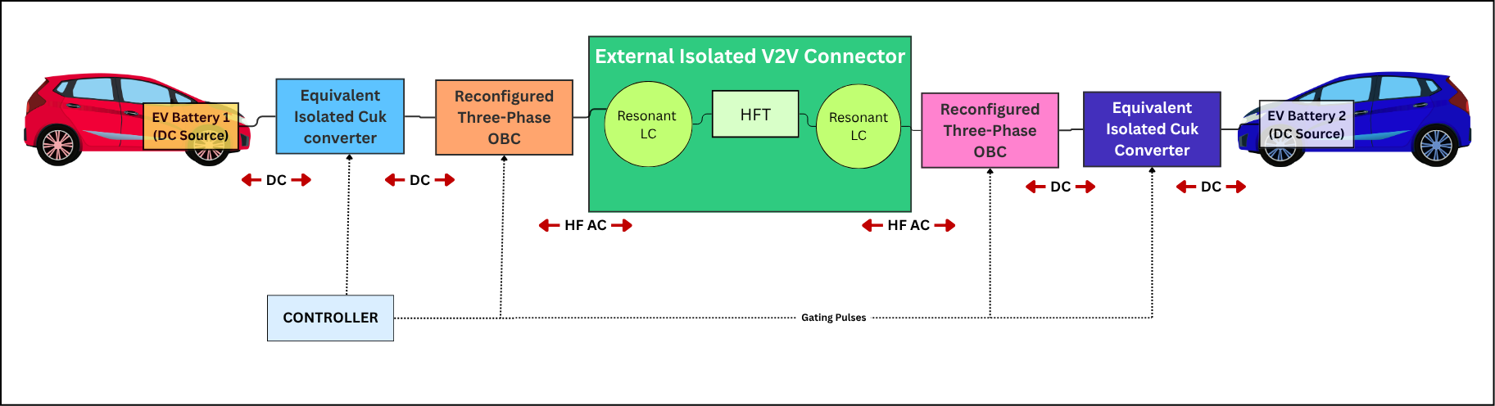
BLOCK DIAGRAM

Slide 5
LITERATURE SURVEY
S.No | Paper Title | Year | Publisher | Relevance to Research | Advantages | Limitations | Key Takeaway
1 | A Novel Isolated Bidirectional Converter for Direct V2V Charging Using OBC | 2026 | Elsevier | Base paper; isolated V2V charging using existing OBC without EV interface redesign | Single-stage converter, HFT galvanic isolation, SiC switches, reduced switching loss, PI-controlled operation | Requires precise OBC synchronization, communication between EVs, laboratory-scale validation only | Strong foundation for isolated OBC-based V2V charging with minimal hardware modifications
2 | United Nations SDG Indicators – Goal 13 | 2021 | United Nations | Establish environmental motivation for EV charging and sustainable transportation | Promotes climate action, carbon emission reduction and clean energy adoption | Does not provide converter design or implementation guidelines | Strengthens the sustainability motivation behind V2V and bidirectional charging research
3 | Review on Unidirectional Non-Isolated High-Gain DC-DC Converters for EV Charging | 2023 | IEEE Access | Study high-gain converter topologies and identify research gaps for EV chargers | Comprehensive comparison of boost-derived converters, voltage gain and efficiency analysis | Focused mainly on unidirectional converters, conduction loss and EMI challenges | Useful reference for topology comparison and identifying future converter improvements

Slide 6
LITERATURE SURVEY
S.No | Paper Title | Year | Publisher | Relevance to Research | Advantages | Limitations | Key Takeaway
4 | Trends in Electric Vehicles Research | 2023 | Elsevier – Transportation Research Part D | Understand recent EV research trends, charging infrastructure and future directions | Covers charging systems, thermal management, sustainability, major research opportunities | Review paper with limited converter-level implementation details | Confirms V2V charging and power electronics as important future EV research areas
5 | Review of Battery Charger Topologies for Plug-In EVs | 2013 | IEEE TPEL | Study charger classifications, charging levels and bidirectional architectures | Comprehensive review of on-board/off-board chargers and multilevel topologies | Older review; excludes recent SiC/GaN devices | Provides strong theoretical background on EV charging architectures
6 | Electric Vehicle-to-Vehicle Energy Transfer Using OBCs | 2023 | IEEE TTE | Direct predecessor of proposed work using existing onboard chargers | 98.4% efficiency, single-stage operation, no interface redesign, low component count | No galvanic isolation, IEC safety concerns, direct battery connection | Proposed isolated topology overcomes safety issues while retaining high efficiency

Slide 7
LITERATURE SURVEY
S.No | Paper Title | Year | Publisher | Relevance to Research | Advantages | Limitations | Key Takeaway
7 | A Multifunctional Single-Phase EV On-Board Charger With a New V2V Charging Assistance Capability | 2020 | IEEE Access | First work proposing V2V charging using existing OBC hardware with galvanic isolation | Multifunctional operation, no extra charging cable, galvanic isolation, utilizes existing OBC hardware | 87% efficiency, four-stage conversion, limited to 3 kW, simulation-focused validation | Demonstrated feasibility of software-based V2V charging using OBC; inspired later single-stage designs
8 | Analysis, Design and Comparison of V2V Chargers for Flexible Grid Integration | 2021 | IEEE Transactions on Industry Applications | Benchmark high-power V2V converter and compare with proposed isolated topology | 97% efficiency, 27 kW operation, SiC devices, compact design, experimentally validated | No galvanic isolation, requires EV interface redesign, higher system cost | Serves as a high-performance benchmark while highlighting benefits of isolated OBC-based solutions
9 | A Novel Universal Magnetic Power Plug to Facilitate V2V/V2G/G2V/V2H Connectivity | 2021 | IEEE Transactions on Industry Applications | Explores universal connector supporting multiple V2X charging modes | Supports V2G, G2V, V2H and V2V, magnetic isolation, reduced EMI, improved safety | Complex magnetic structure, higher cost, requires infrastructure standardization | Presents a promising universal V2X charging interface for future smart-grid applications

Slide 8
LITERATURE SURVEY
S.No | Paper Title | Year | Publisher | Relevance to Research | Advantages | Limitations | Key Takeaway
10 | Integrated Converter With G2V, V2G and DC/V2V Charging Capabilities for SRM Drive EV Application | 2023 | IEEE Transactions on Industry Applications | Study integrated converter architecture combining traction and charging functions | Reduced converter count, compact structure, supports G2V, V2G and V2V operations, improved hardware utilization | Complex operating modes, advanced control required, SRM torque ripple and acoustic noise | Demonstrates compact multifunctional EV power converter with reduced hardware redundancy
11 | High-Frequency Transformer Isolated Bidirectional DC-DC Converter Modules | 2011 | IEEE Transactions on Power Electronics | Study isolated bidirectional converter design and distributed control concepts | 97.2% efficiency, high-frequency galvanic isolation, adaptive inductor, reduced switch count | Complex adaptive control, difficult transformer design, not developed specifically for EV charging | Provides valuable isolated converter design concepts applicable to V2V charger development
12 | A Unified Amplifier-Based CC-CV Linear Charger for Energy-Constrained Applications | 2018 | IEEE Transactions on Circuits and Systems II | Understand bidirectional charging strategy and multi-mode V2X energy transfer | Supports charging/discharging, V2G and V2V operation, improved energy utilization and smart-grid compatibility | Complex control strategy, requires protection circuitry and advanced charging infrastructure | Highlights flexible bidirectional charging architecture for future energy-sharing EV networks

Slide 9
LITERATURE SURVEY
S.No | Paper Title | Year | Publisher | Relevance to Research | Advantages | Limitations | Key Takeaway
13 | Review on Classification of Resonant Converters for EV Applications | 2022 | Elsevier | Study LLC/CLLC resonant topologies, soft-switching techniques and converter selection | High efficiency, ZVS/ZCS operation, bidirectional capability, wide soft-switching range | Variable-frequency control, resonant tank optimization, complex digital controller | Useful reference for selecting resonant topology and optimizing converter performance
14 | An efficient and compact voltage feed-forward DAB-based bidirectional DC–DC converter for onboard EV charger | 2025 | Elsevier | Compare DAB architecture with proposed resonant converter for V2V charging | 95% efficiency, galvanic isolation, bidirectional power flow, compact high-frequency design | High circulating current, transformer leakage effects. | DAB offers excellent performance but with higher control complexity than proposed topology
15 | Decentralized Energy Management for Urban Charging Hubs | 2023 | IEEE TTE | Understand V2G coordination, smart charging and energy management strategies | Real-time charging control, aggregator coordination, smart-grid integration | Focuses mainly on EMS algorithms, limited converter hardware discussion | Valuable for integrating intelligent energy management into future V2V chargers

Slide 10
OBJECTIVE
To design and develop an isolated single stage bidirectional V2V converter for EV Charging using existing On Board Chargers (OBC) and a resonant HFT link for galvanic isolation.
To analyze converter performance for different load and supply variations.
To design and validate a closed-loop controller that enables stable, bidirectional charging (EV1- EV2 and EV2 - EV1), under varying state-of-charge (SOC) conditions on both sides.

Slide 11
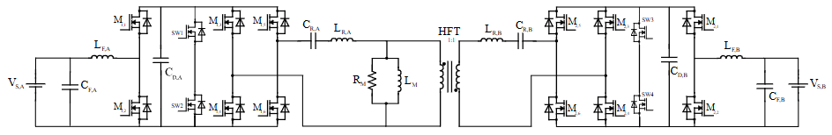
CIRCUIT DIAGRAM
Fig. 1. Proposed isolated bidirectional V2V charging topology adopted from Base Paper [1].

Slide 12
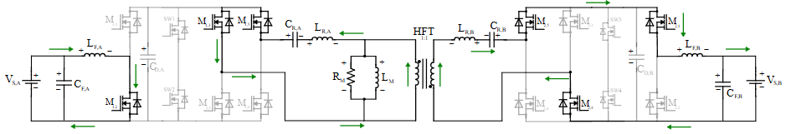
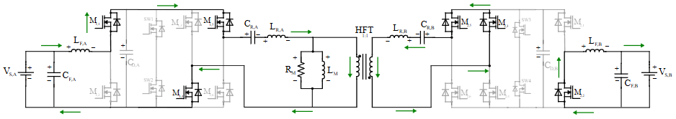
MODES OF OPERATIONS
Charging from EV1 to EV2
STAGE 1
Discharges stored energy into the resonant network
Receives resonant energy and delivers it to the output stage
Stores magnetic energy - charging
Releases stored energy to the battery
Battery 1 supplies power
Transfers energy through magnetic coupling while providing galvanic isolation
Battery 2 receives the charging power
STAGE 2
Charges from the source side bridge and inductor
Transfers resonant energy towards output stage
Releases the stored energy
Stores magnetic energy - charging
Battery 2 continues charging

Slide 13
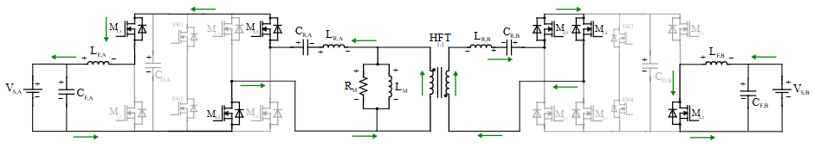
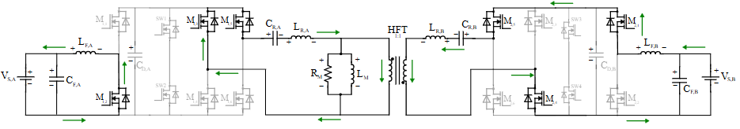
MODES OF OPERATIONS
Charging from EV2 to EV1
STAGE 1
Receives resonant energy and delivers it to the output stage
Discharges stored energy into the resonant network
Releases stored energy to the battery
Stores magnetic energy - charging
Battery 1 receives the charging power
Transfers energy through magnetic coupling while providing galvanic isolation
Battery 2 supplies power
STAGE 2
Transfers resonant energy towards output stage
Charges from the source side bridge and inductor
Stores magnetic energy - charging
Releases the stored energy
Battery 1 continues charging

Slide 14
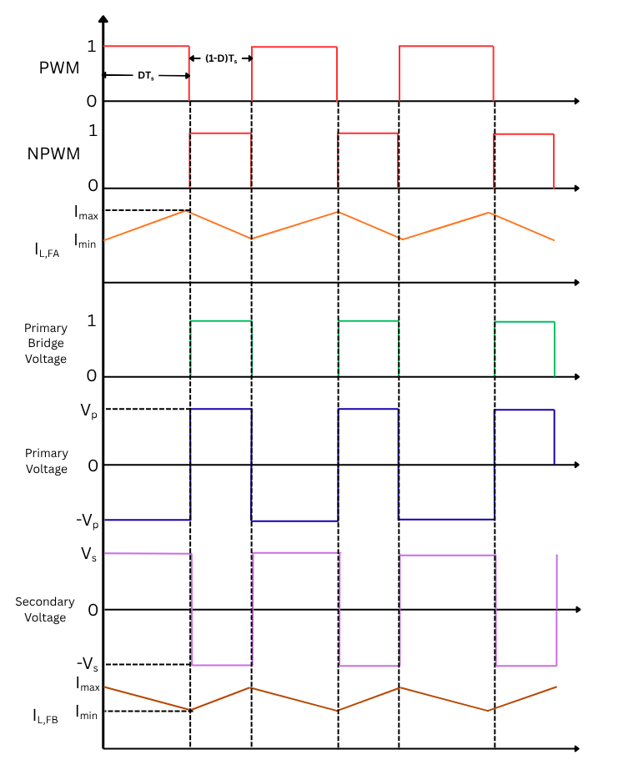
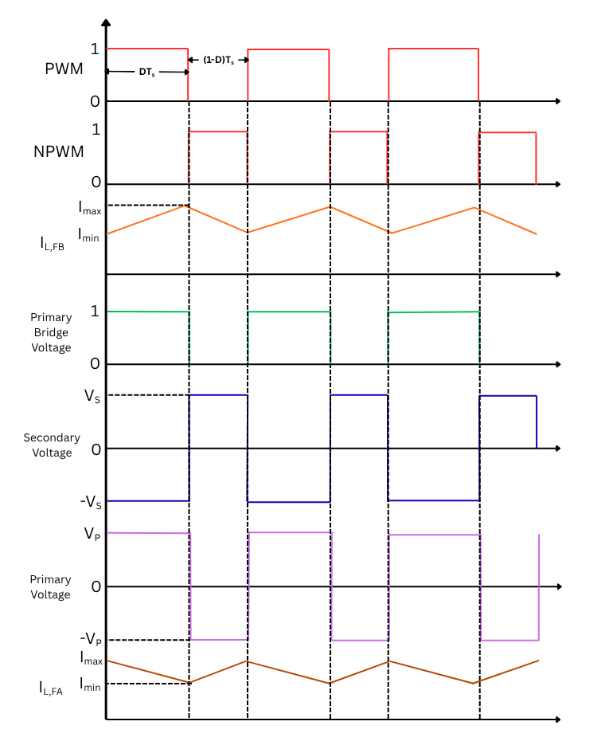
THEORETICAL WAVEFORMS
Charging from EV1 to EV2
Charging from EV2 to EV1
Vd
Vd

Slide 15
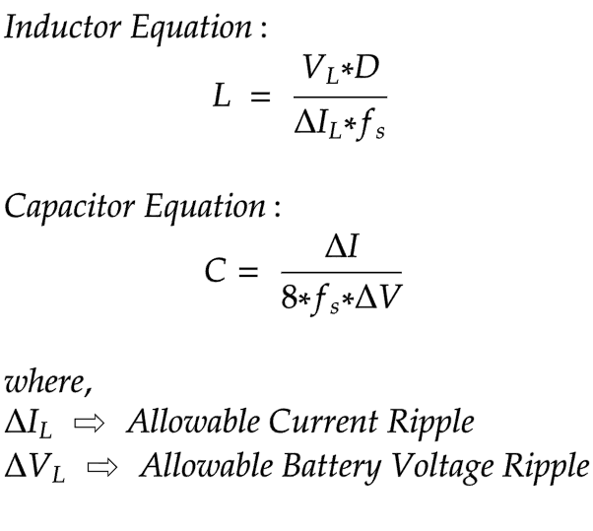
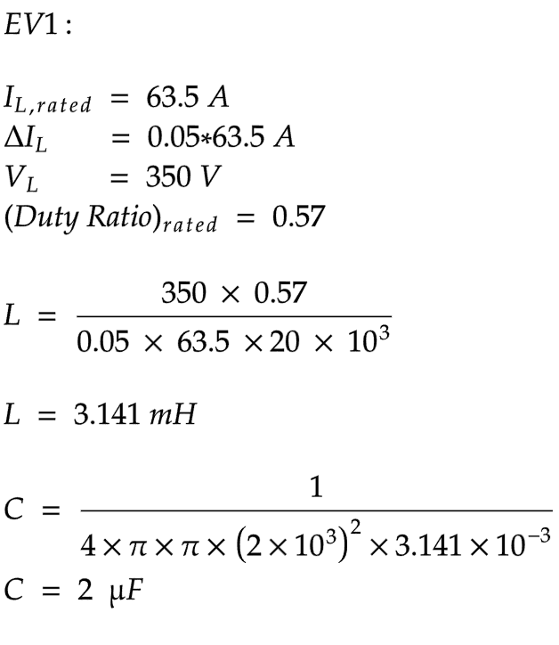
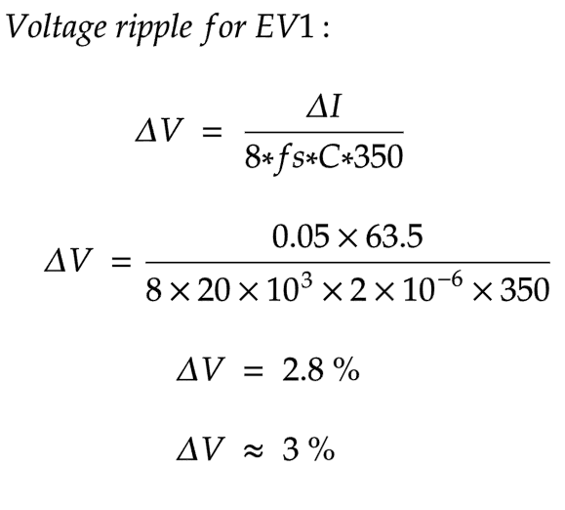
BATTERY SIDE - FILTER DESIGN EQUATIONS

Slide 16
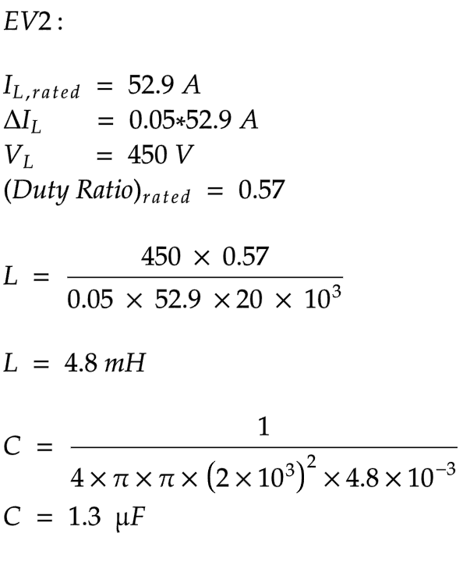


BATTERY SIDE - FILTER DESIGN EQUATIONS
Gain equation:
Where,
V_{S,B} is the EV2 Side Battery Voltage
V_{S,A} is the EV1 Side Battery Voltage
α is the duty ratio

Slide 17
CONVERTER SPECIFICATION
Parameter | Value
EV1 battery pack capacity | 60 Ah
EV2 battery pack capacity | 80 Ah
EV1 battery pack nominal voltage | 350 V
EV2 battery pack nominal voltage | 450 V
Filter Inductance, L_{F,A} | 3.14mH
Filter Inductance, L_{F,B} | 4.8 mH
Filter Capacitance, C_{F,A} | 2 μF
Filter Capacitance, C_{F,B} | 1.3 μF
Resonant Capacitor, C_{R,A} | 0.21 mF
Resonant Capacitor, C_{R,B} | 0.21 mF
Resonant (Leakage) Inductor, L_{R,A} | 0.3015 μH
Resonant (Leakage) Inductor, L_{R,B} | 0.3015 μH
DC Link Capacitor, C_{D,A} | 0.5 mF
DC Link Capacitor, C_{D,B} | 0.8 mF
Switching Frequency, f_{s} | 25 kHz

Slide 18
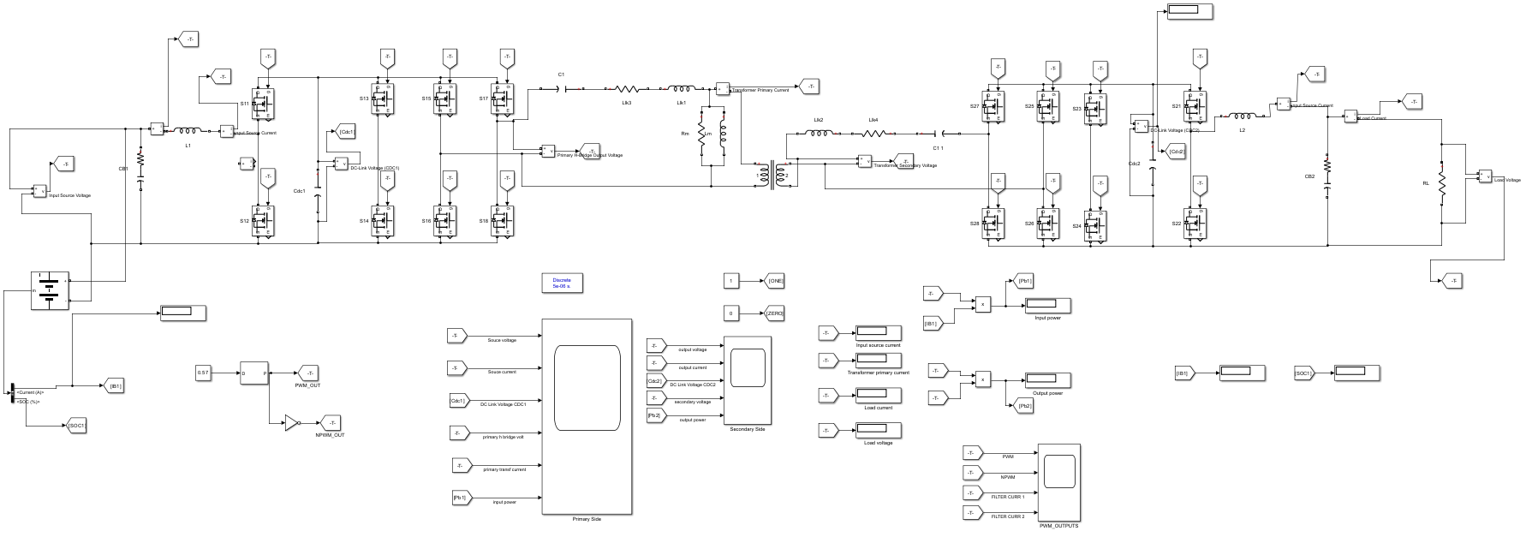
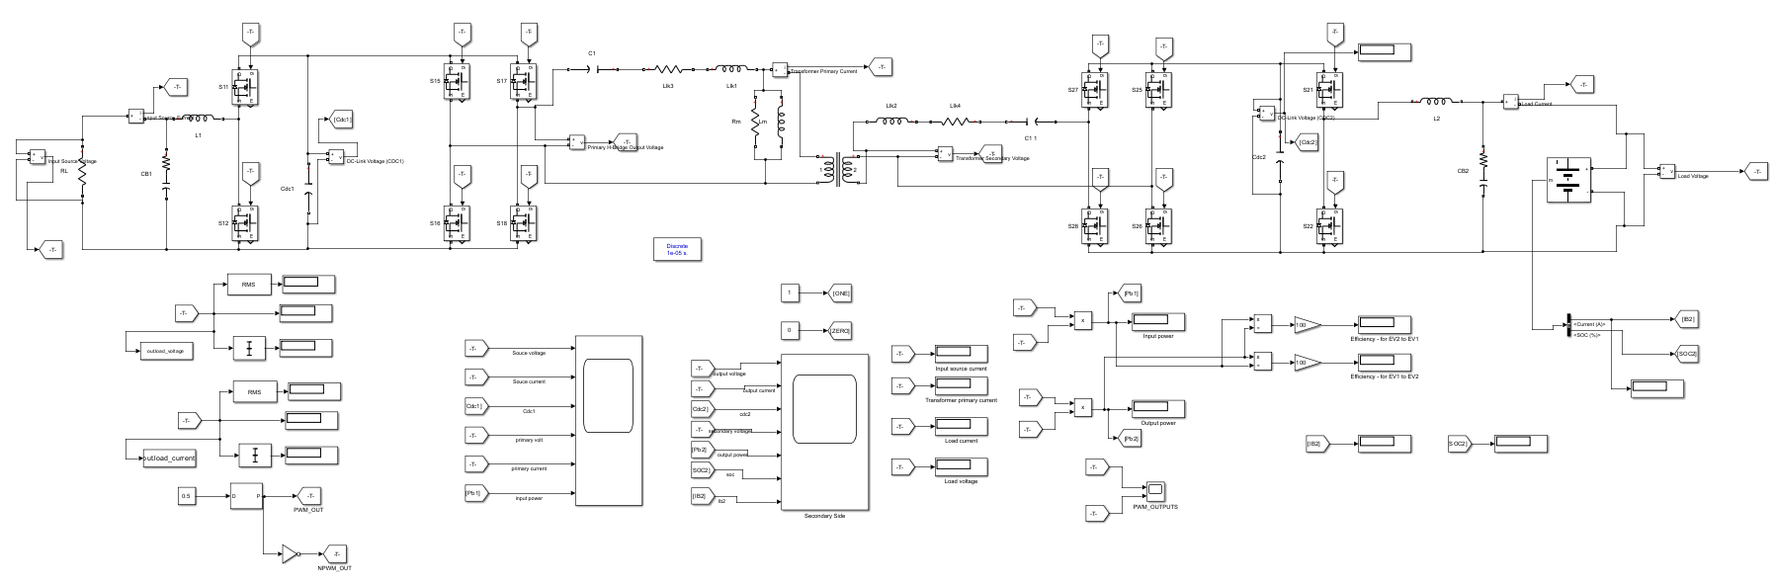
OPEN LOOP – SIMULATION SETUP

Slide 19
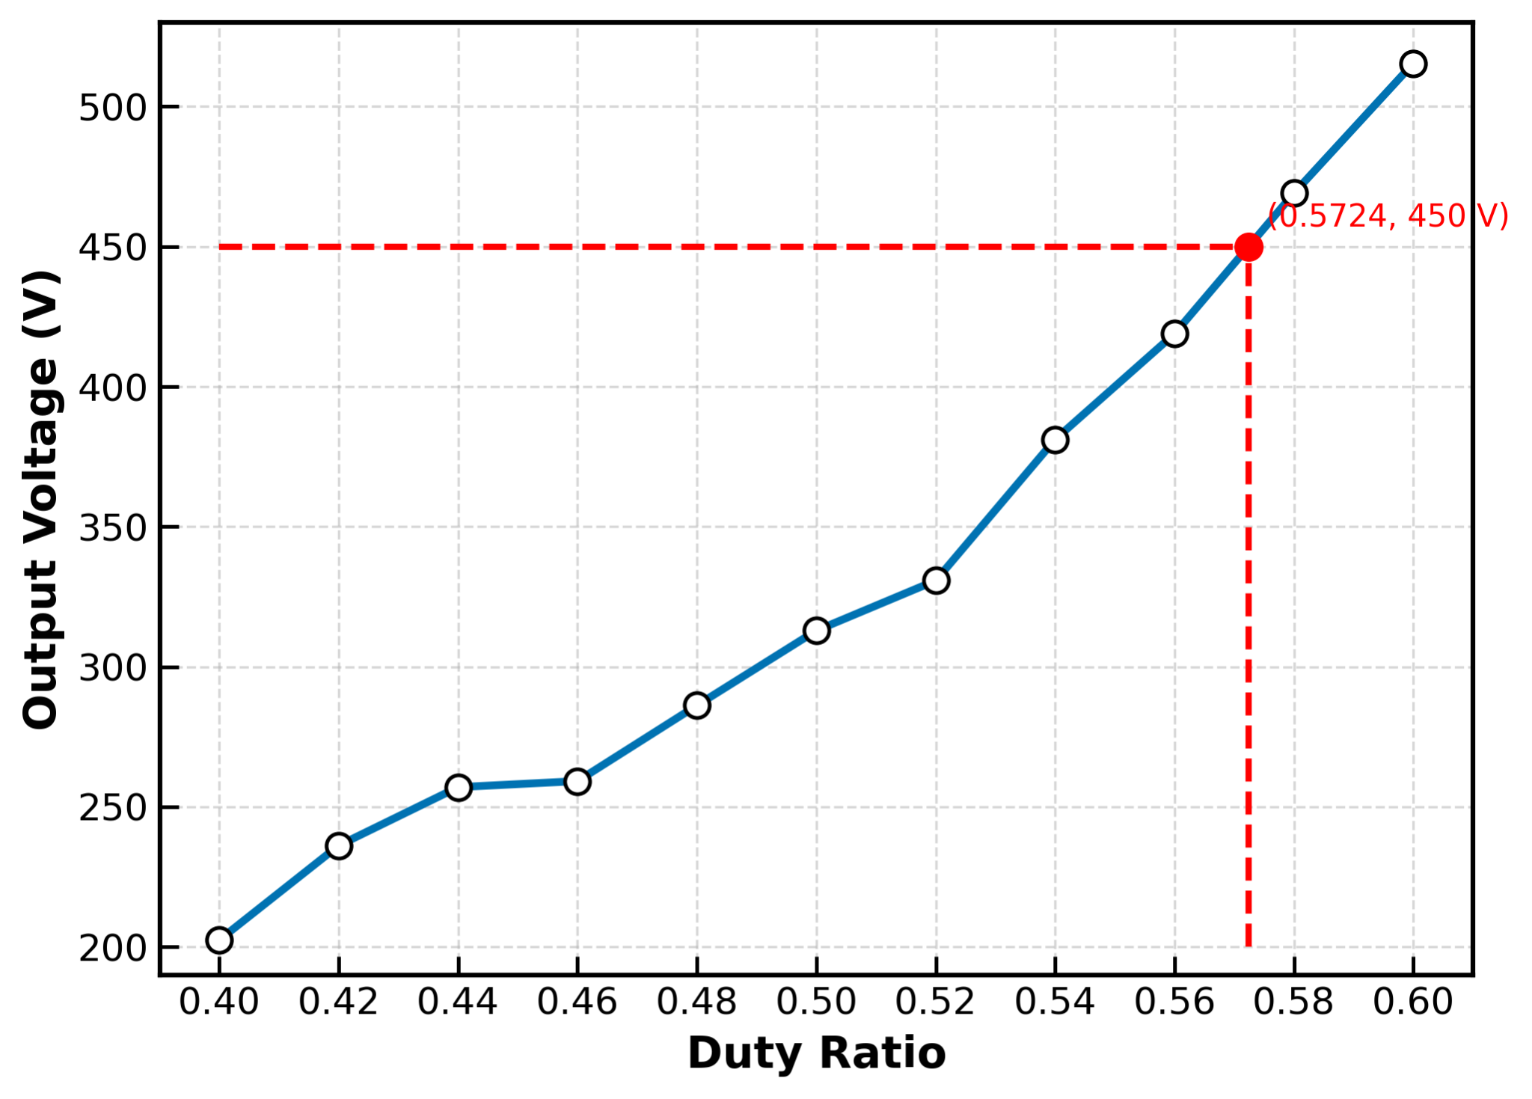
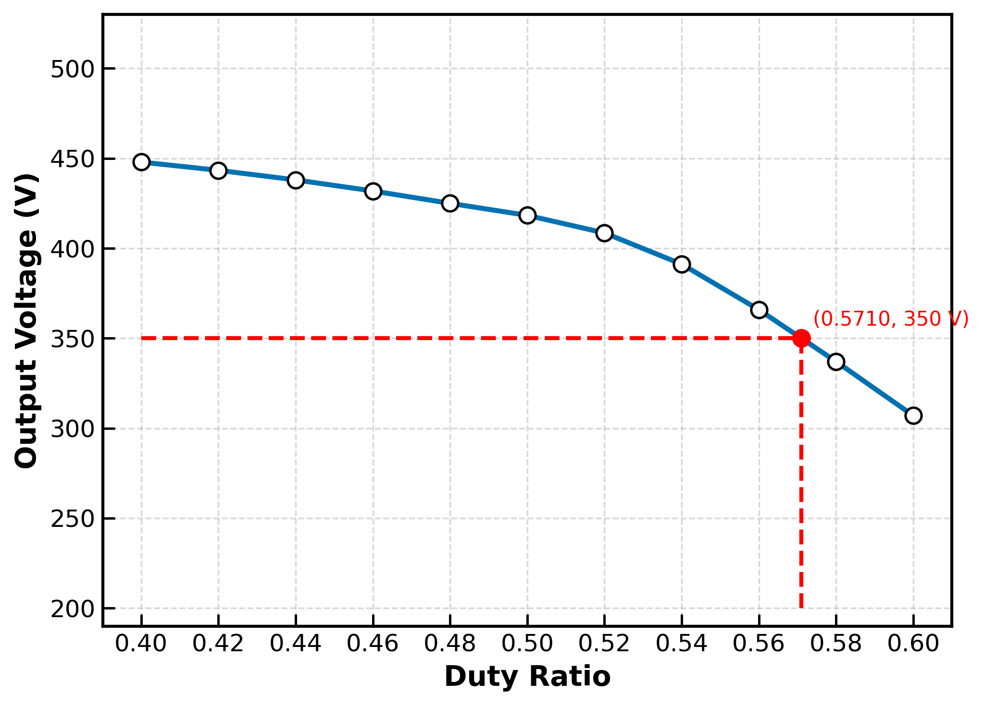
PERFORMANCE CURVES – OPEN LOOP
MODE-1 MODE-2

Slide 20
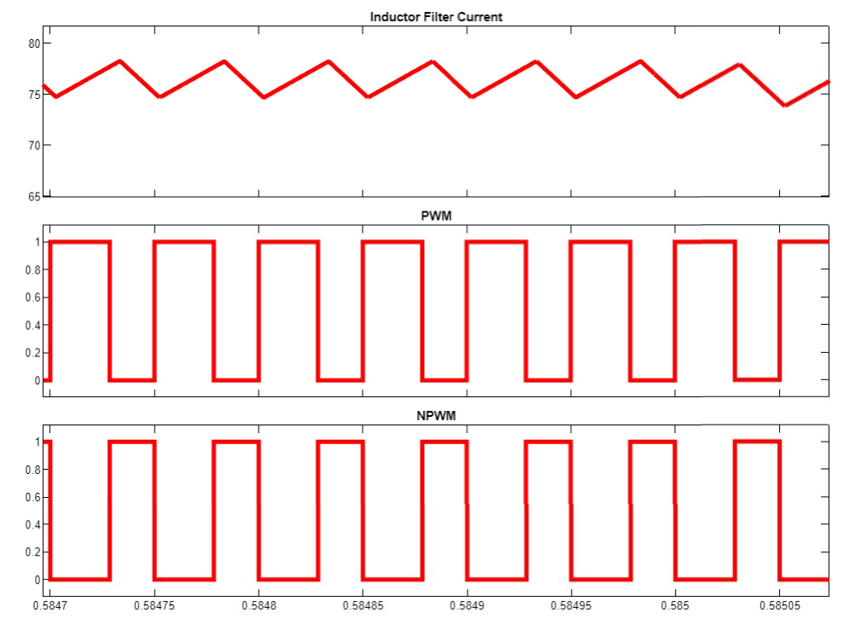
OUTPUT - EV1 charging EV2
Current(A)
Voltage(V)
Voltage(V)
Time(s)

Slide 21
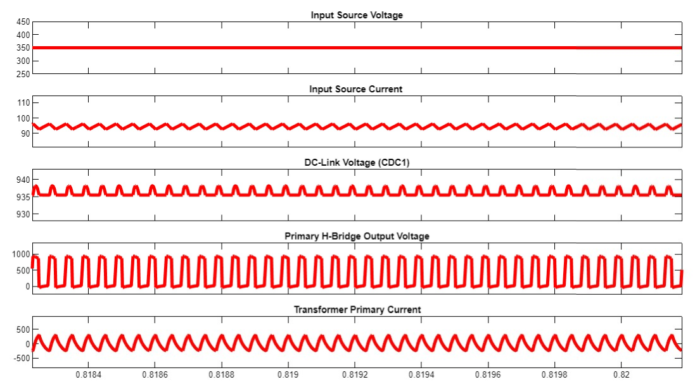
OUTPUT (MODE 1 - EV1 - SOURCE)
Voltage(V)
Current(A)
Voltage(V)
Voltage(V)
Current(A)
Time(s)

Slide 22
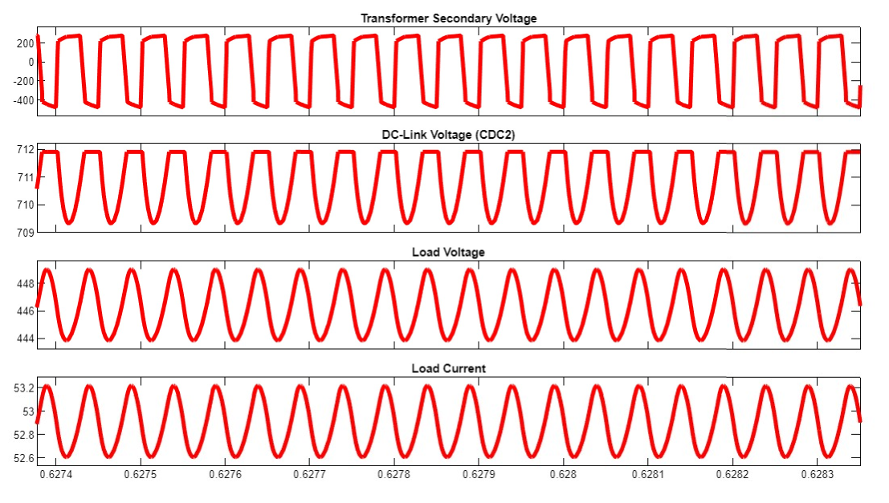
OUTPUT (MODE 1 - EV2 - LOAD)
Voltage(V)
Voltage(V)
Voltage(V)
Current(A)
Time(s)

Slide 23
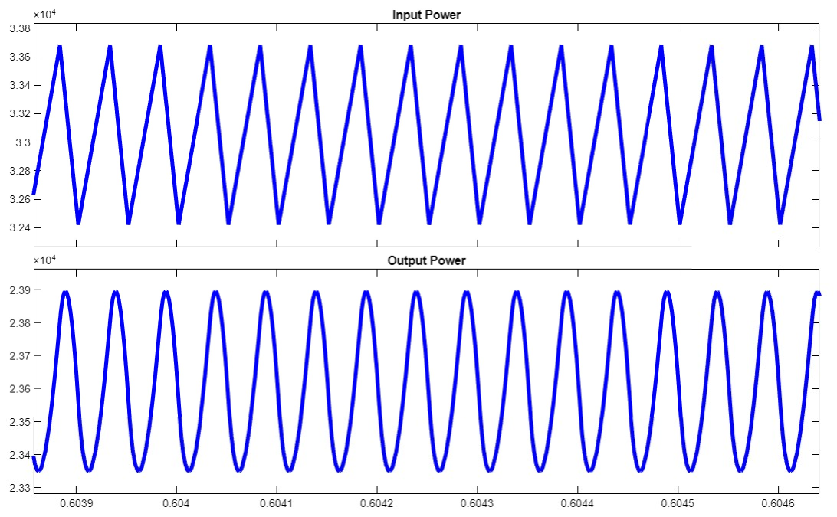
OUTPUT (MODE 1 - POWER)
Power(W))
Power(W))
Time(s)

Slide 24
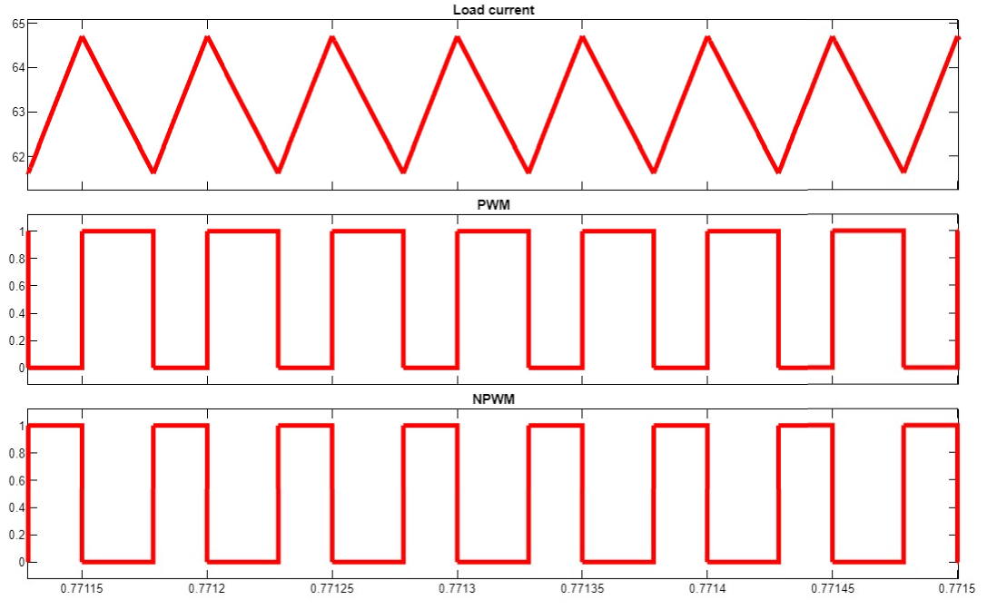
OUTPUT (EV2 charging EV1)
Current(A)
Voltage(V)
Voltage(V)
Time(s)

Slide 25
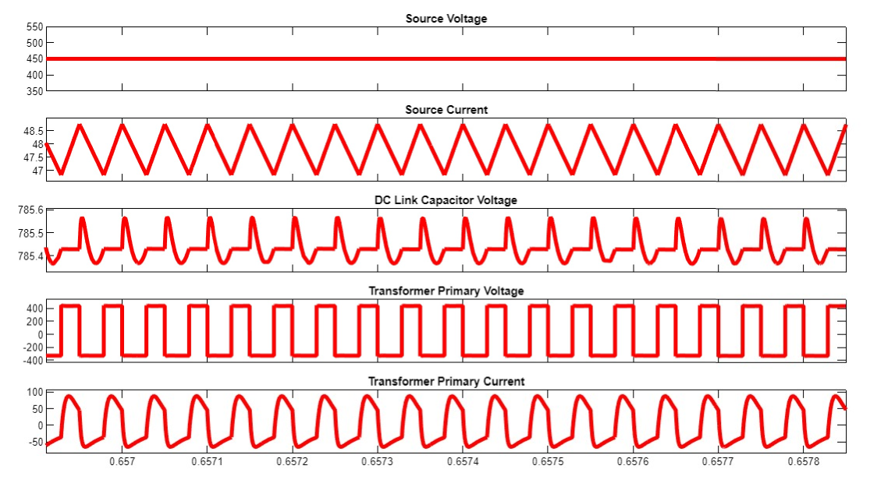
OUTPUT (MODE 2 - EV2 - SOURCE)
Voltage(V)
Current(A)
Voltage(V)
Voltage(V)
Current(A)
Time(s)

Slide 26
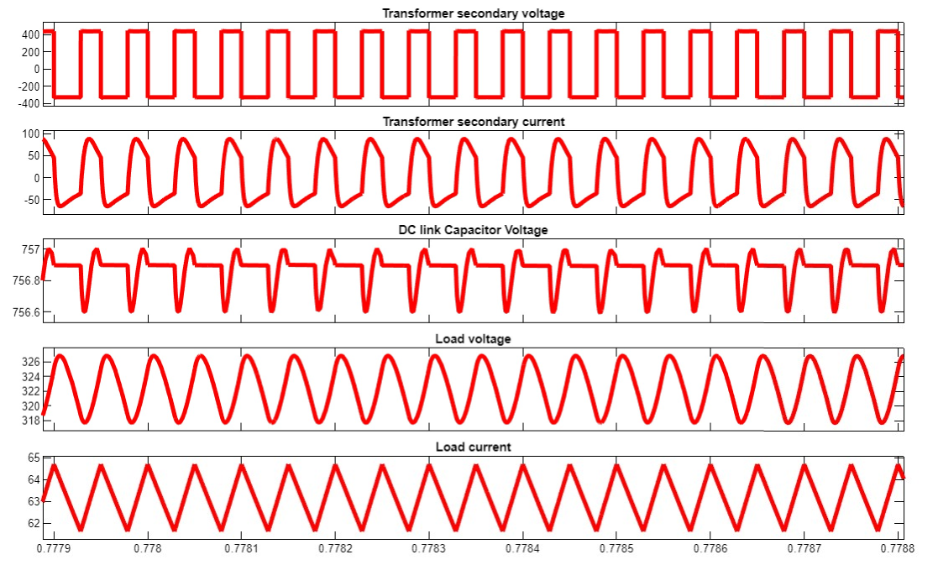
OUTPUT (MODE 2 - EV1 - LOAD)
Voltage(V)
Current(A)
Voltage(V)
Voltage(V)
Current(A)
Time(s)

Slide 27
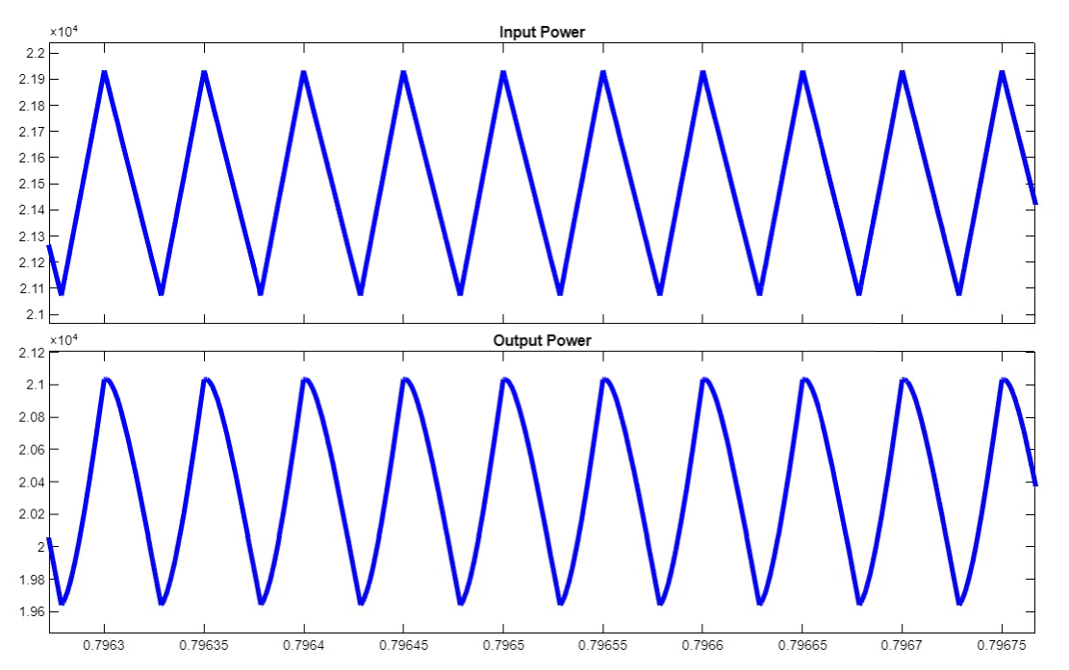
OUTPUT (MODE 2 - POWER)
Power(W))
Power(W))
Time(s)

Slide 28
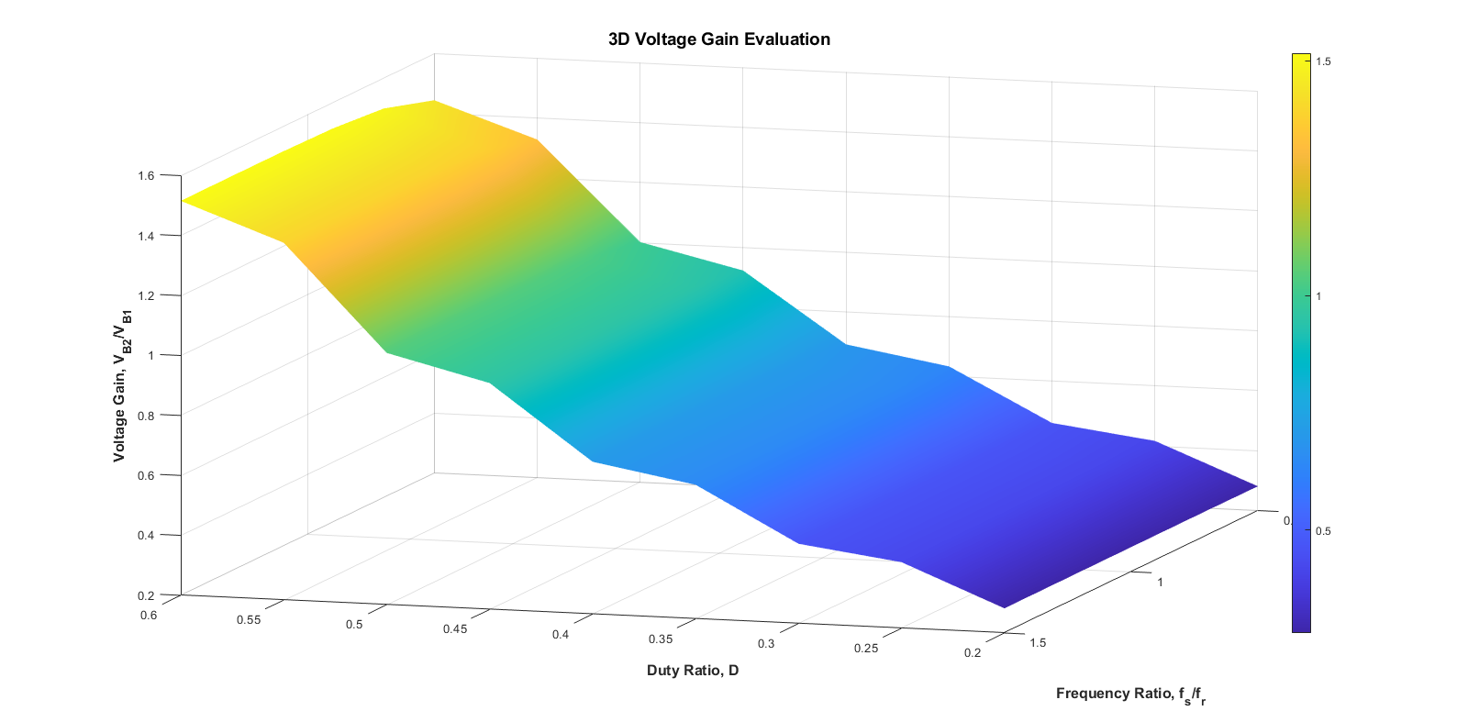
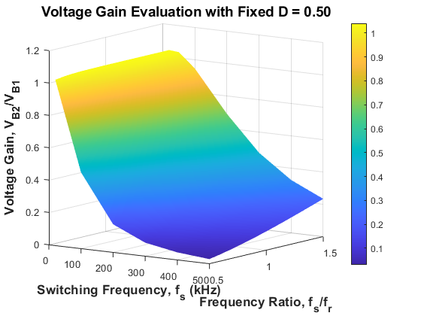
VOLTAGE GAIN 3D PLOT
Voltage gain peaks at F_{S} /F_{r} =1 duty-ratio analysis identifies suitable operating points for both charging directions.

Slide 29
CLOSED LOOP ANALYSIS
The Ziegler-Nichols method is used to tune the PI controller for accurate charging current regulation
It provides fast transient response, stable operation, and minimal overshoot during V2V charging
The proportional gain (Kp) is initially set to zero and the integral gain (Ki) is gradually increased until the system reaches sustained oscillations.
The ultimate gain (Ku) and ultimate period (Pu) are recorded from the oscillatory response.
Ziegler-Nichols equations:
Kp=0.45Ku Ti=Pi/1.2 Ki =Kp/Ti
The fine tuned values for V2V charging is found to be Kp=0.0001 and Ki=0.015

Slide 30
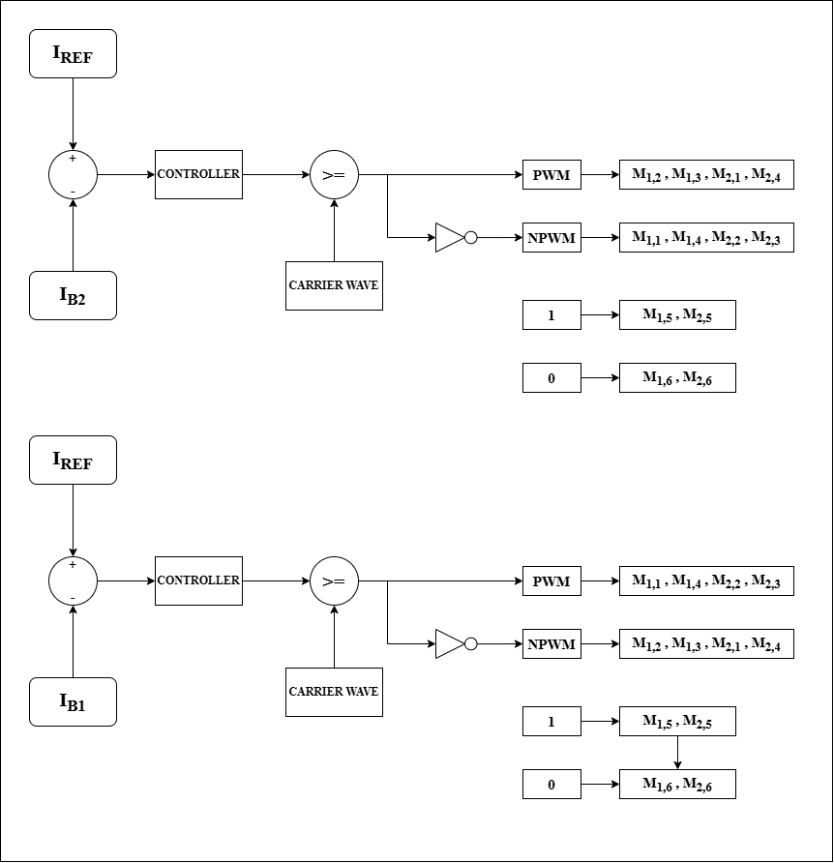
CLOSED LOOP – CONTROL ALGORITHM
MODE 1: MODE 2:

Slide 31
DESIGN OF CONTROLLERS
The bidirectional V2V converter employs three control strategies for constant-current (CC) charging in both EV1 → EV2 and EV2 → EV1 power-transfer modes.
Proportional Integral Controller
Integral Sliding Mode Controller
Fuzzy Logic Controller

Slide 32
PROPORTIONAL INTEGRAL CONTROLLER
Regulates charging current through duty-ratio adjustment based on current-tracking error.
Tuning: Ziegler–Nichols (ZN) method.
Gains: K_p=0.0001, K_i=0.015
Proportional action ensures immediate error response; integral action minimizes steady-state error.
Implemented using a discrete PI controller integrated with PWM and mode-selection logic.

Slide 33
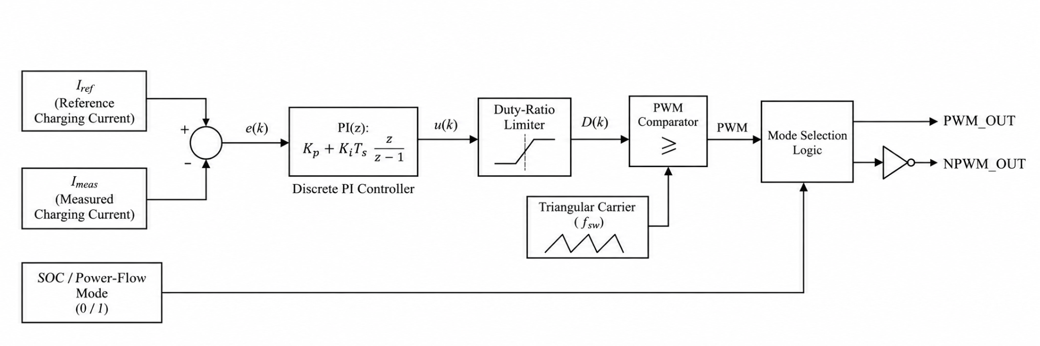
PROPORTIONAL INTEGRAL CONTROLLER - BLOCK DIAGRAM

Slide 34
INTEGRAL SLIDING MODE CONTROLLER
Combines instantaneous and accumulated current error through an integral sliding surface.
Parameters: lambda=2, phi=0.5, k=0.005, D₀=0.5
Saturation-based control correction limits the switching action and mitigates chattering.
Duty-ratio command is integrated with bidirectional PWM and gate-signal generation.

Slide 35
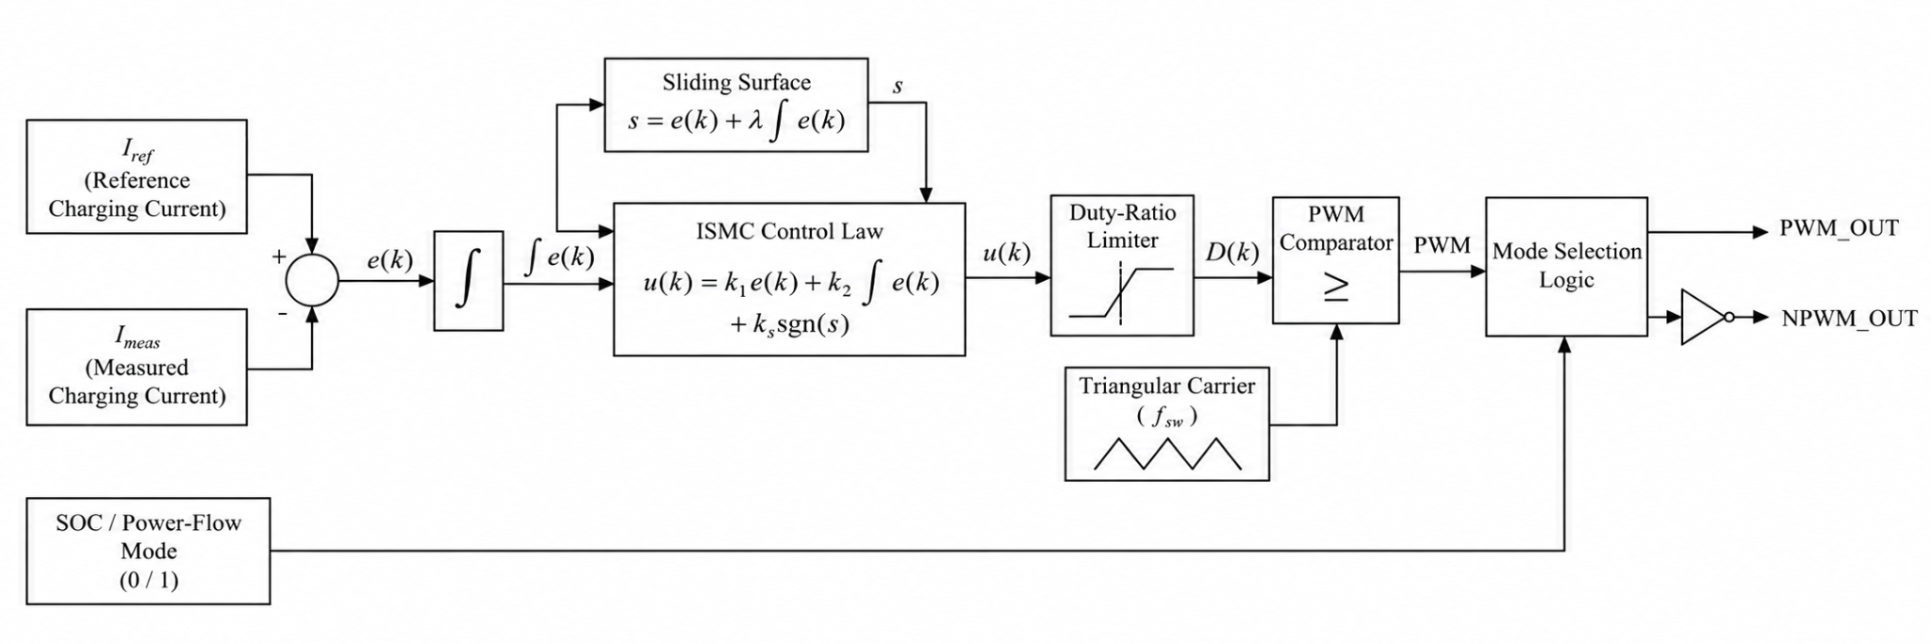
INTEGRAL SLIDING MODE CONTROLLER- BLOCK DIAGRAM

Slide 36
FUZZY LOGIC CONTROLLER
Mamdani FIS uses current error and change in error to determine the control command.
Inputs: 5 triangular membership functions each (NB, NS, Z, PS, PB); output: 3 (Low, Medium, High).
Inference: 25 rule entries, min–max operators and centroid defuzzification.
Implemented in MATLAB/Simulink with PWM and mode-selection logic for bidirectional charging.

Slide 37
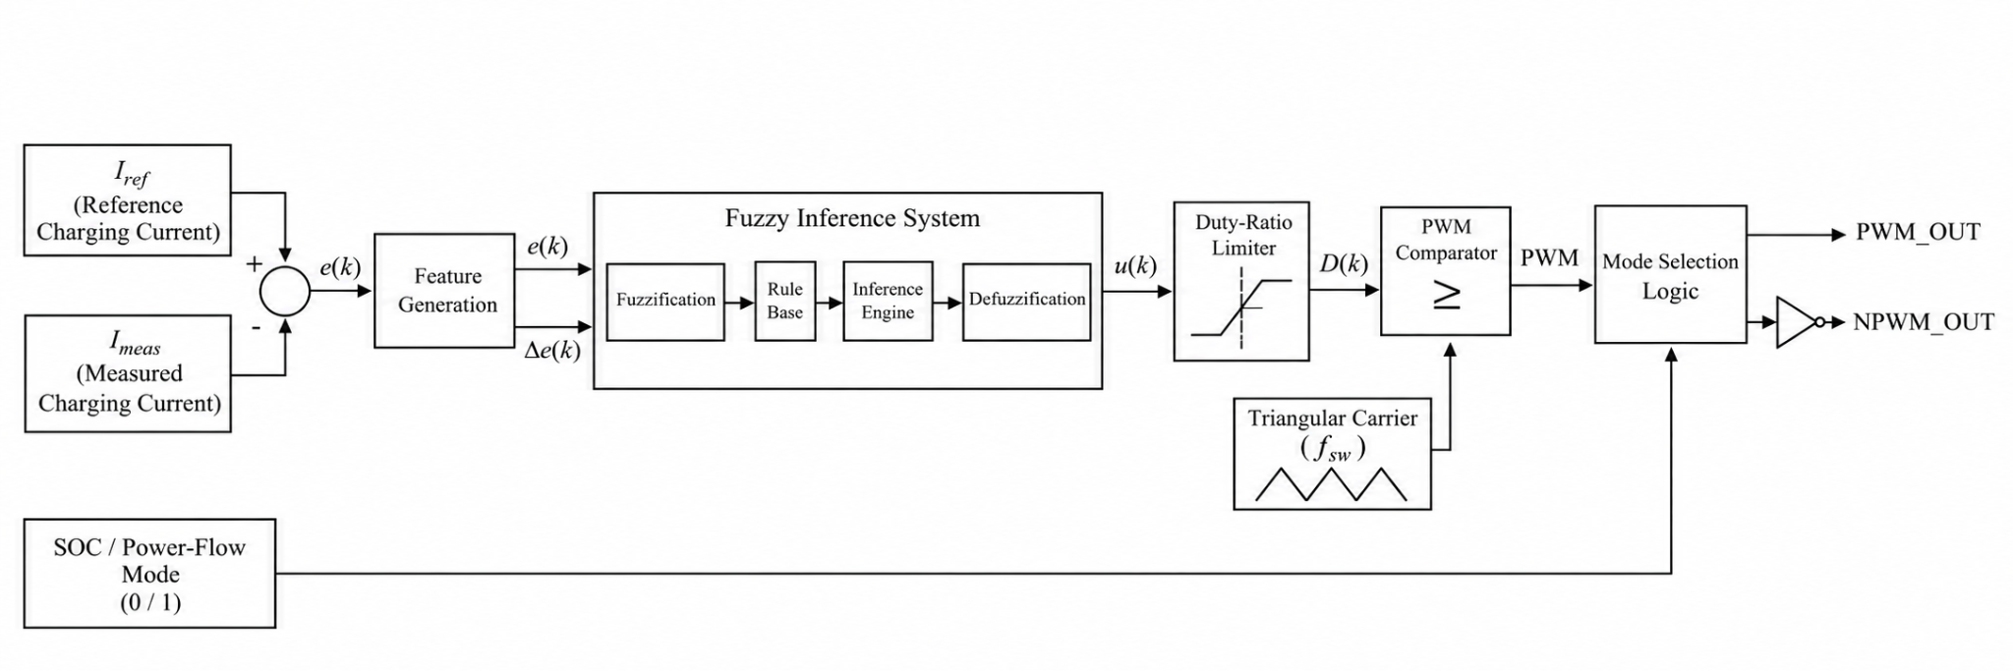
FUZZY LOGIC CONTROLLER- BLOCK DIAGRAM

Slide 38
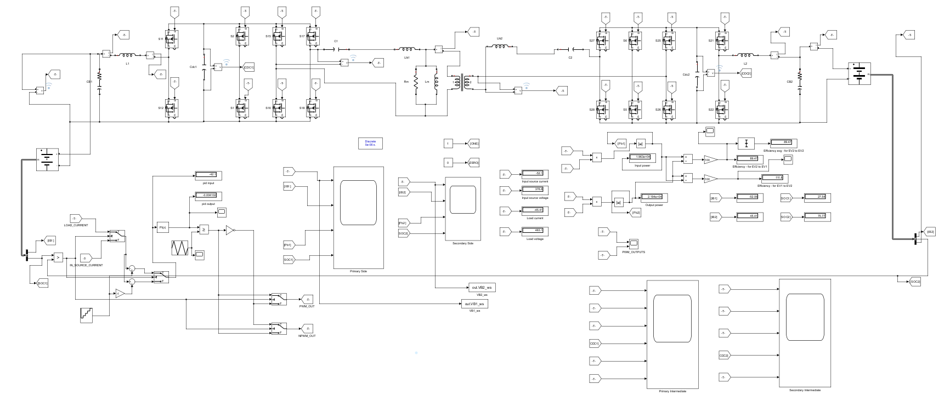
CLOSED LOOP – SIMULATION SETUP

Slide 39
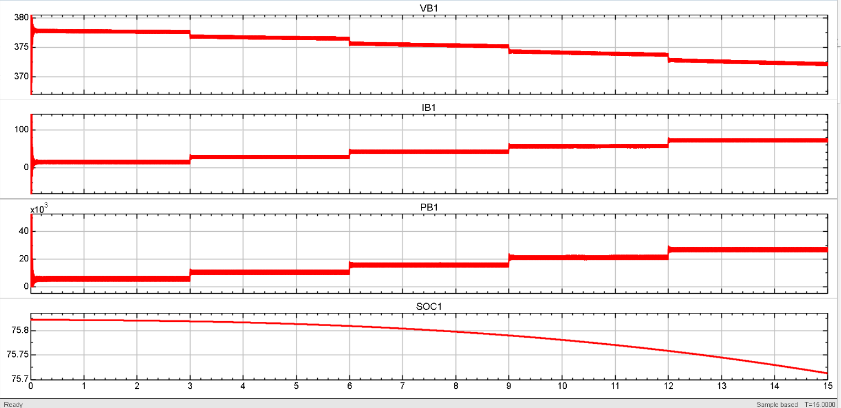
PI CONTROLLER OUTPUT MODE 1 EV1 PARAMETERS
Voltage (V)
Current(A)
Power (W)
SoC (%)
Time(s)

Slide 40
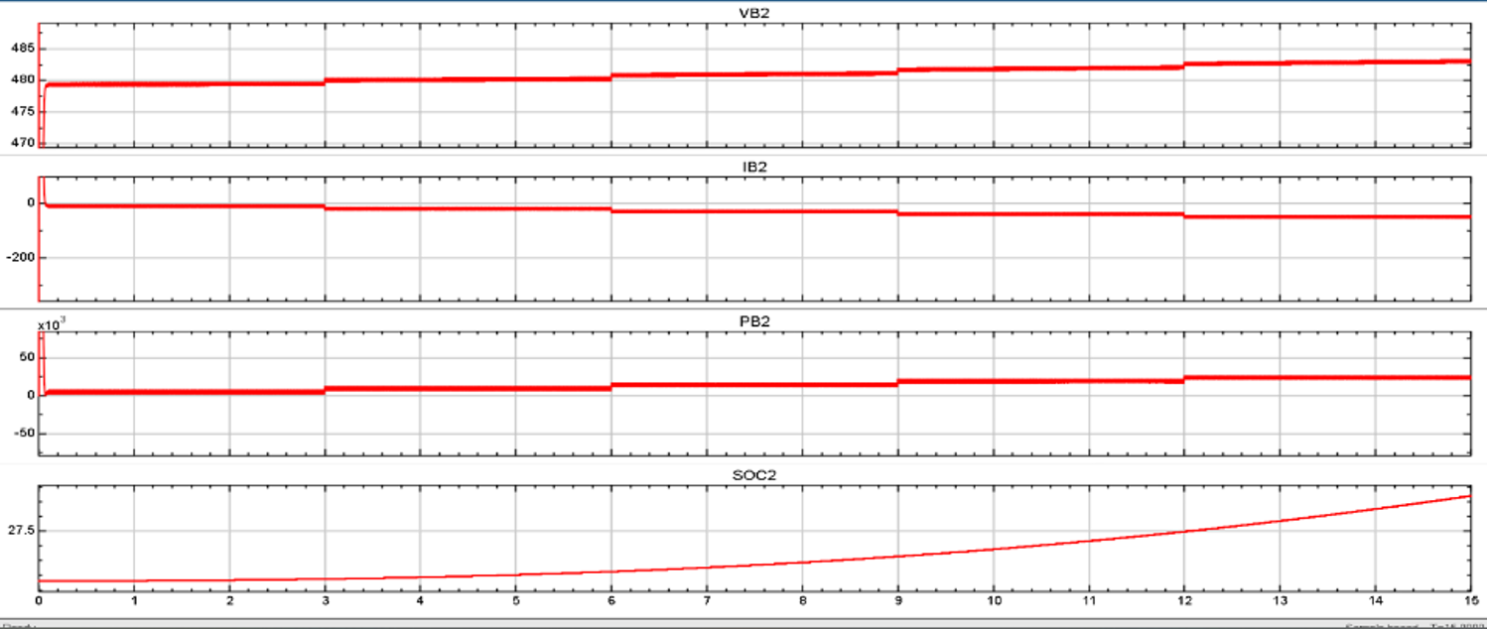
PI CONTROLLER OUTPUT MODE 1 EV2 PARAMETERS
Voltage (V)
Current(A)
Power (W)
SoC (%)
Time(s)

Slide 41
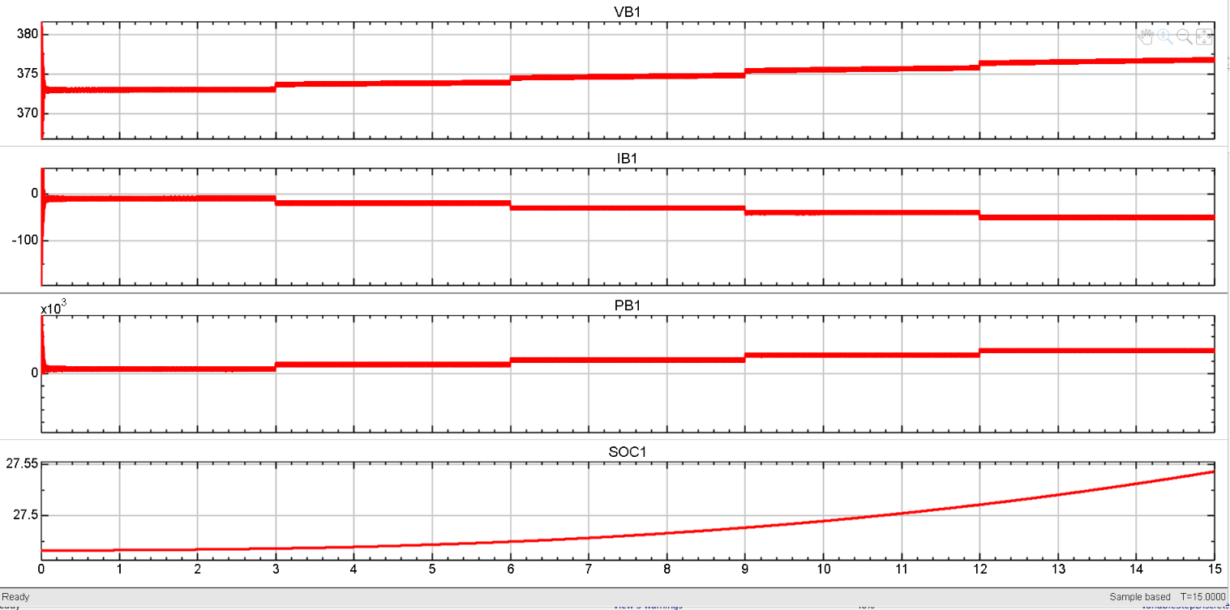
PI CONTROLLER OUTPUT MODE 2 EV1 PARAMETERS
Voltage (V)
Current(A)
Power (W)
SoC (%)
Time(s)

Slide 42
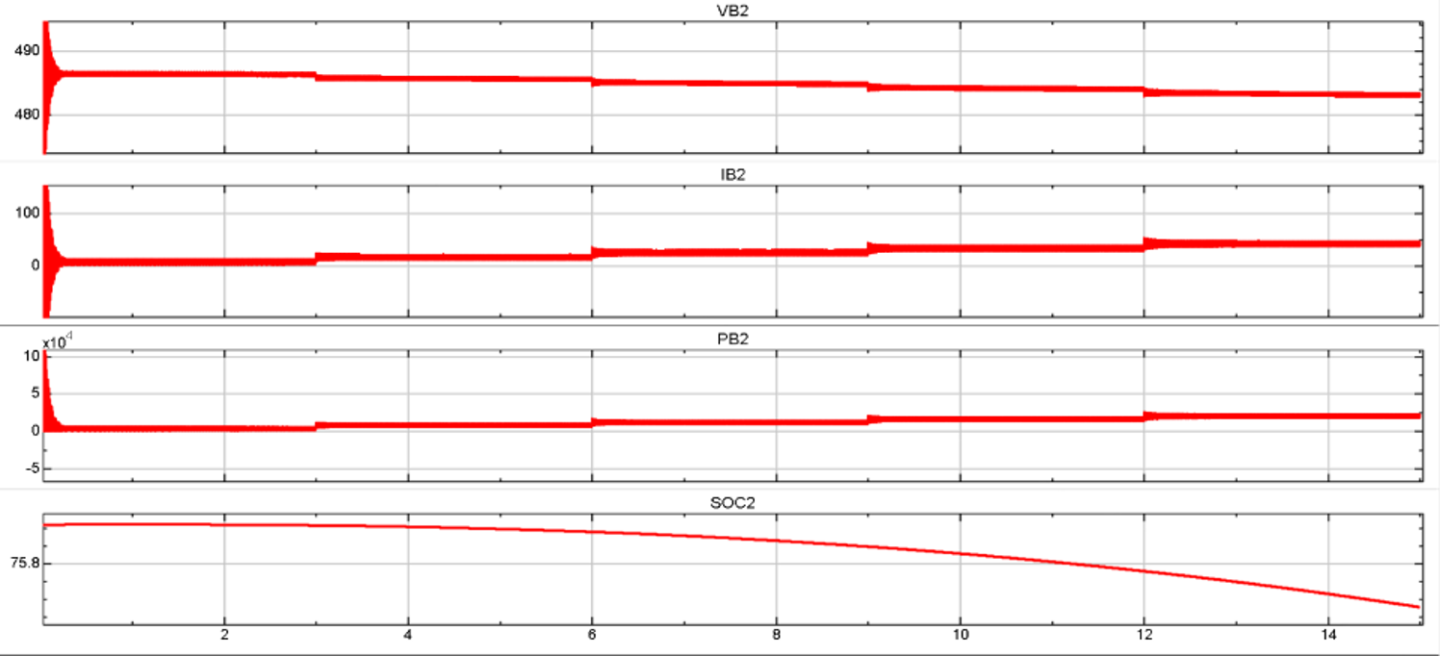
PI CONTROLLER OUTPUT MODE 2 EV2 PARAMETERS
Voltage (V)
Current(A)
Power (W)
SoC (%)
Time(s)

Slide 43
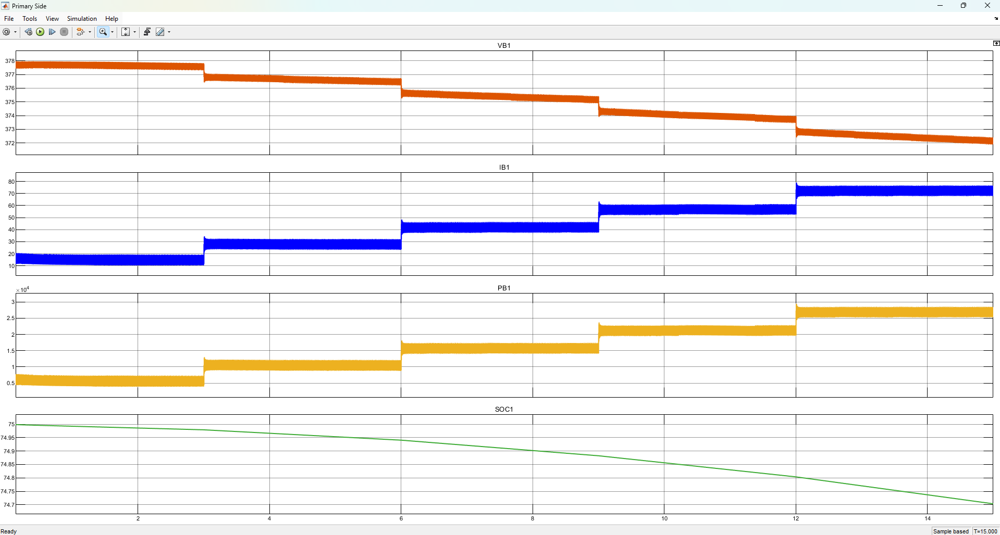
ISMC CONTROLLER -SIMULATION RESULTS
Mode 1 EV 1 Parameters using ISMC Controller

Slide 44
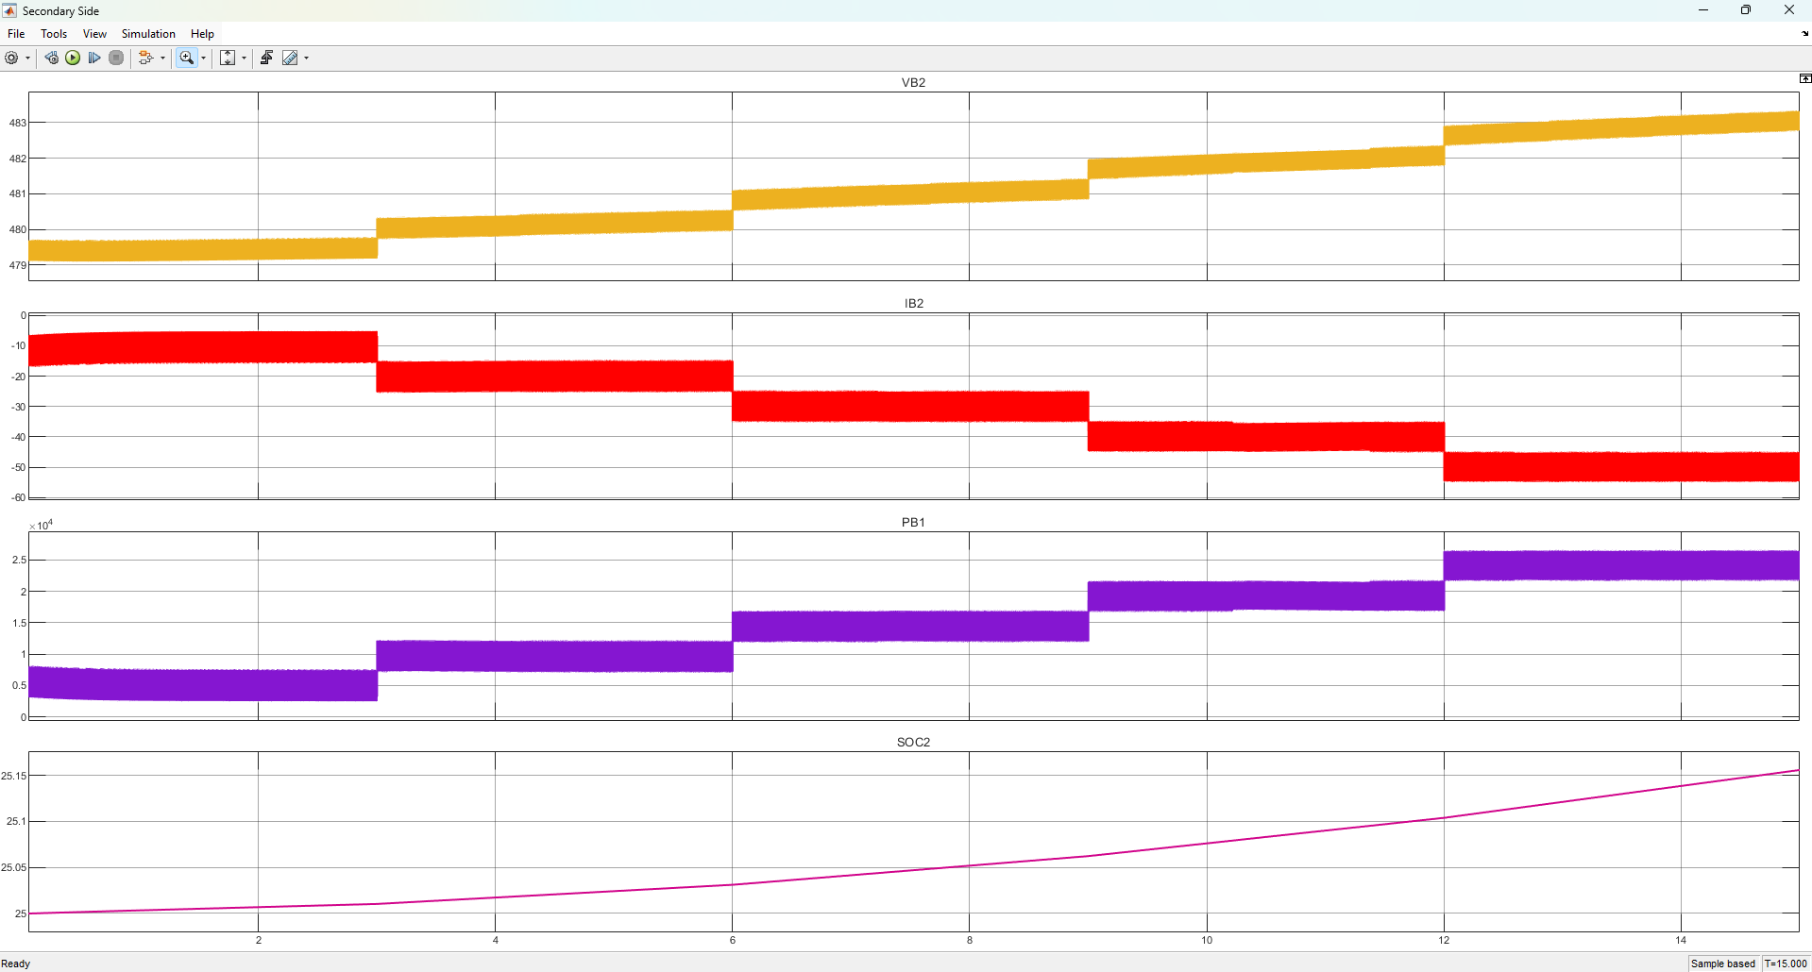
ISMC CONTROLLER -SIMULATION RESULTS
Mode 1 EV 2 Parameters using ISMC Controller

Slide 45
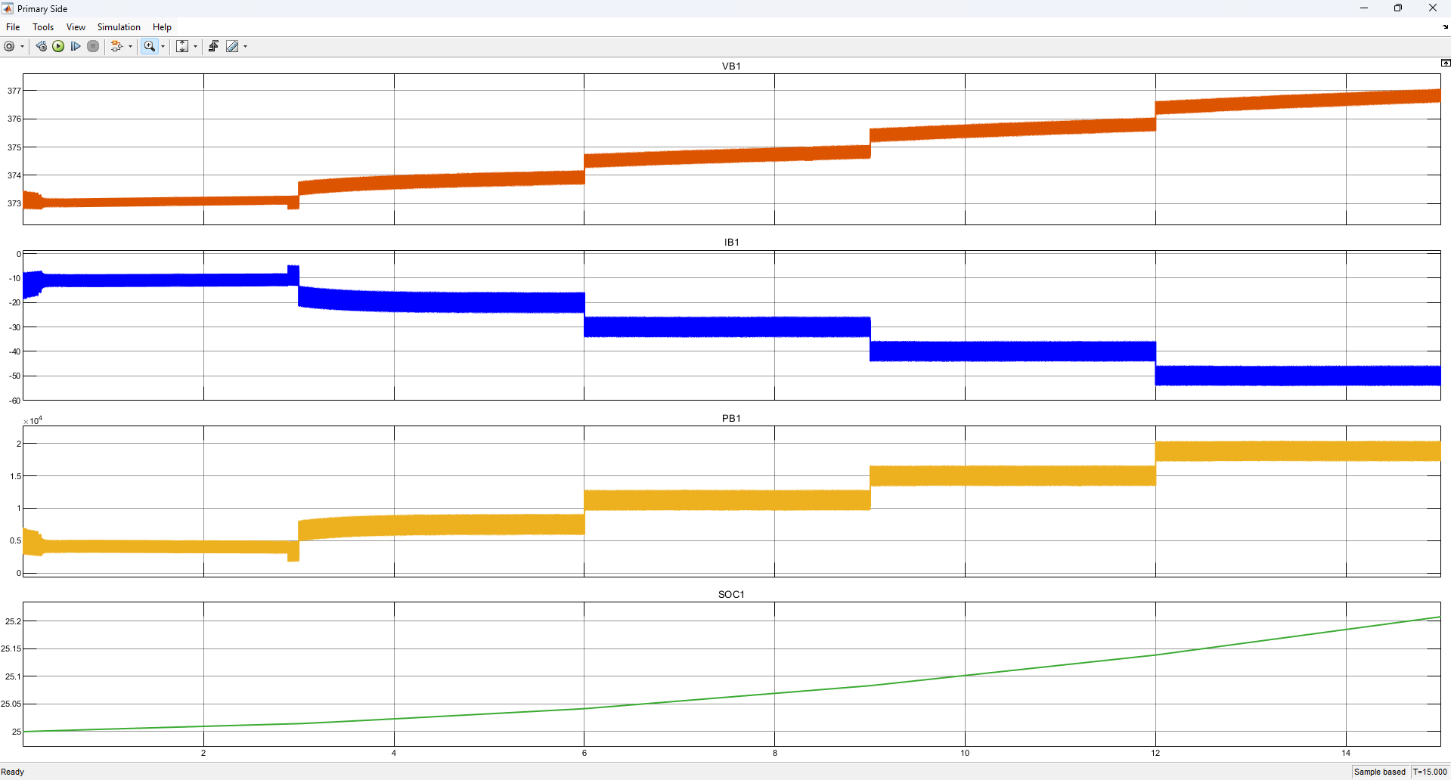
ISMC CONTROLLER -SIMULATION RESULTS
Mode 2 EV 1 Parameters using ISMC Controller

Slide 46
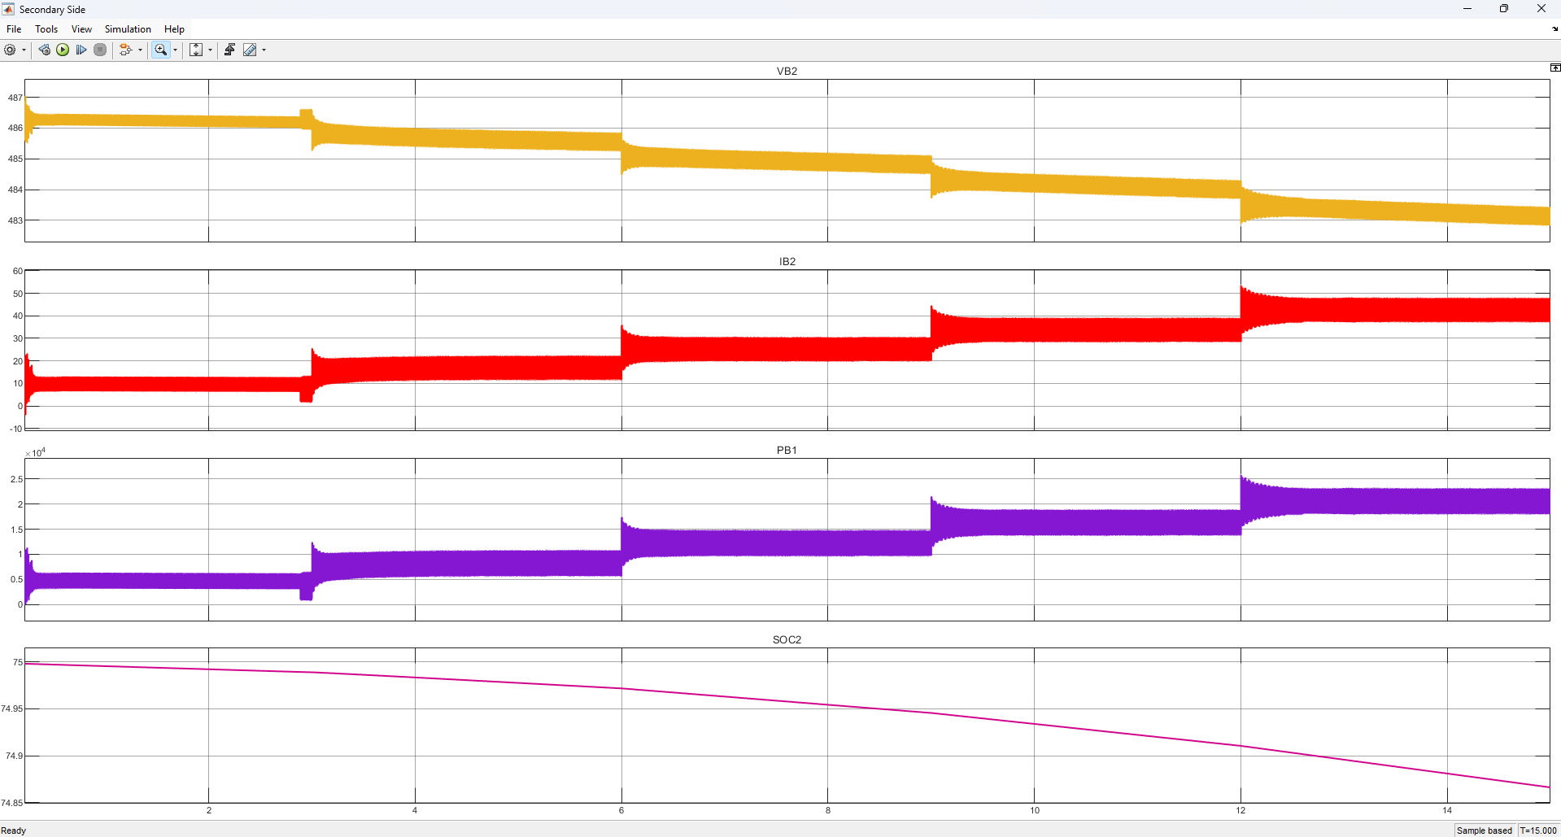
ISMC CONTROLLER -SIMULATION RESULTS
Mode 2 EV 2 Parameters using ISMC Controller

Slide 47
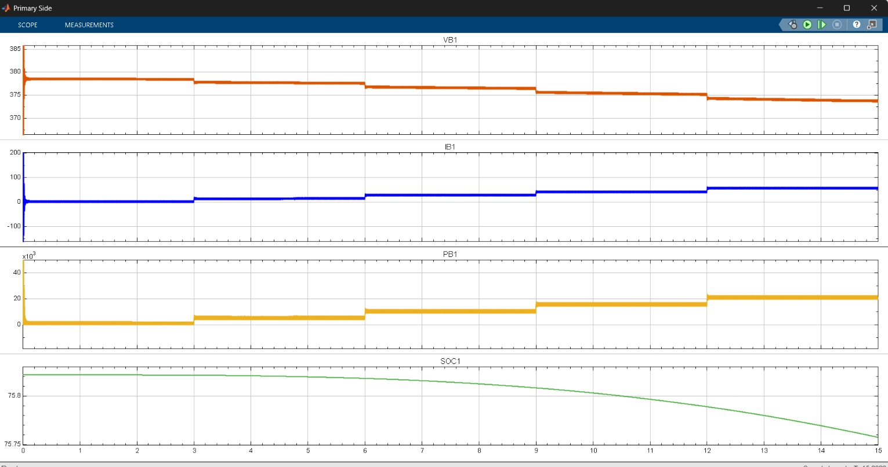
FUZZY CONTROLLER -SIMULATION RESULTS
Mode 1 EV 1 Parameters using Fuzzy Logic Controller

Slide 48
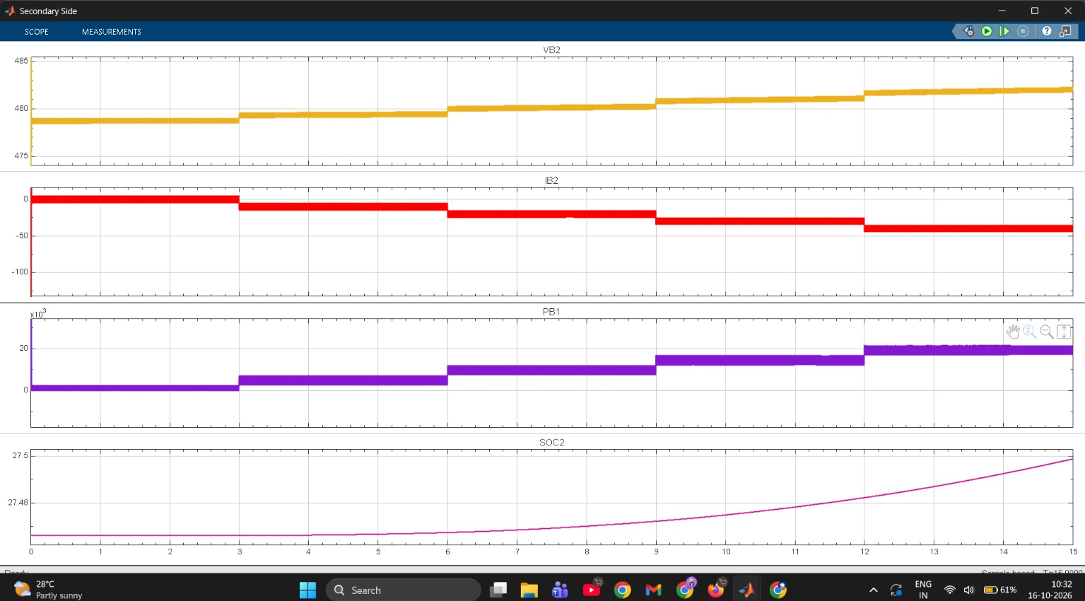
FUZZY CONTROLLER -SIMULATION RESULTS
Mode 1 EV 2 Parameters using Fuzzy Logic Controller

Slide 49
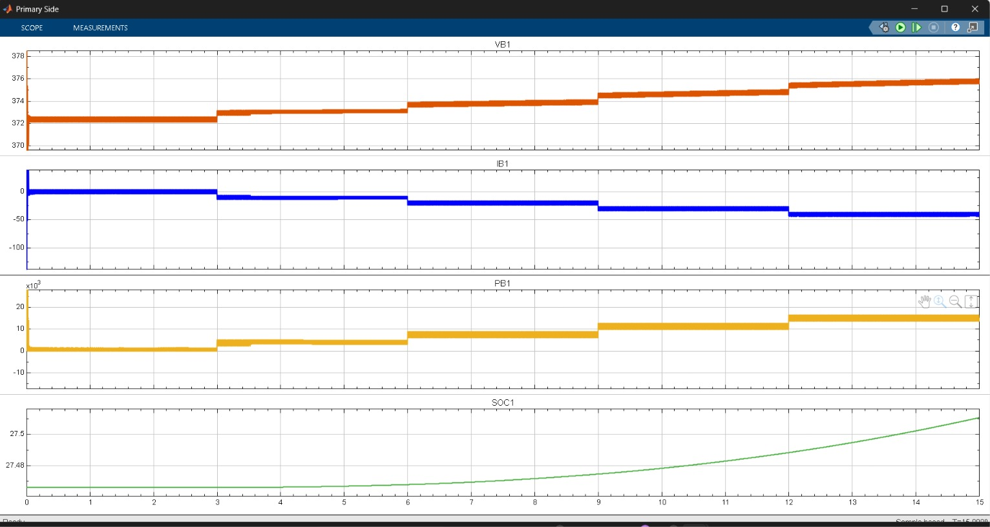
FUZZY CONTROLLER -SIMULATION RESULTS
Mode 2 EV 1 Parameters using Fuzzy Logic Controller

Slide 50
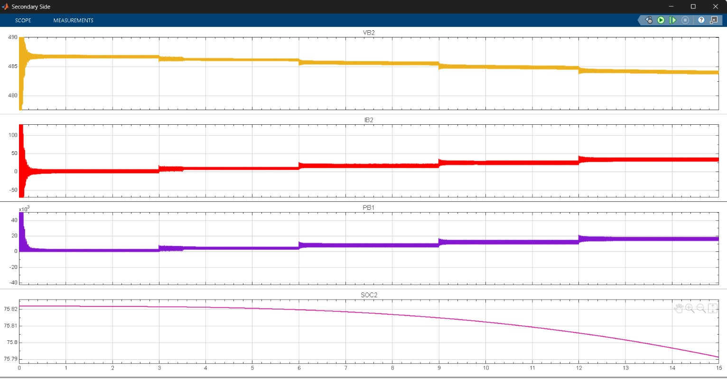
FUZZY CONTROLLER -SIMULATION RESULTS
Mode 2 EV 2 Parameters using Fuzzy Logic Controller

Slide 51
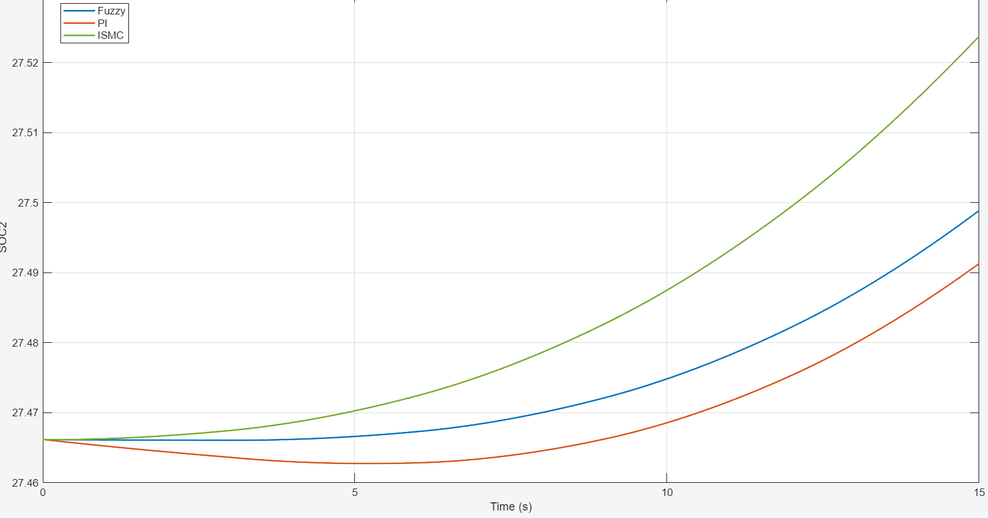
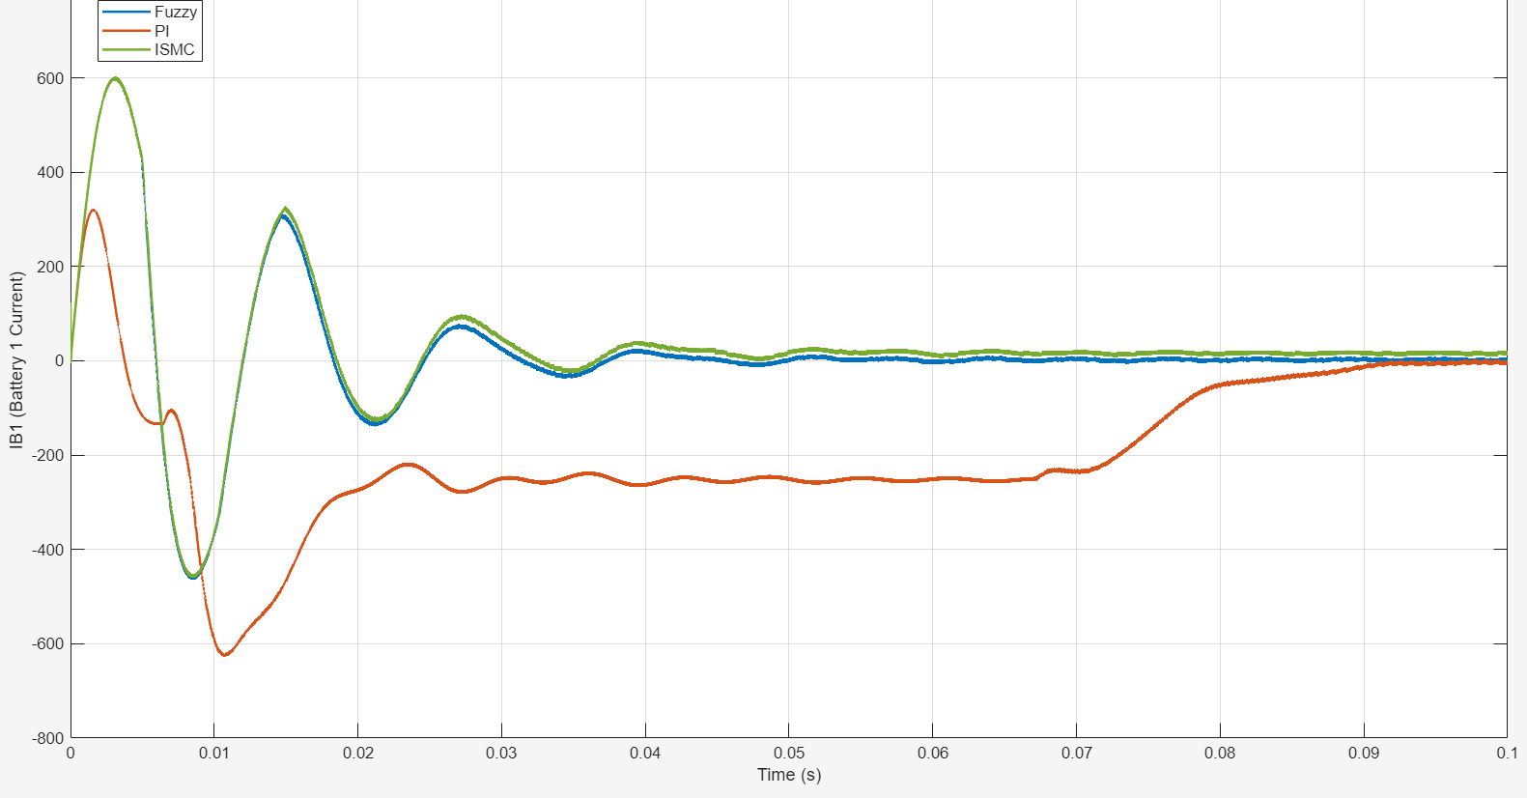
Comparison of PI, ISMC and Fuzzy Logic Controllers
PI controller: Stable response but exhibits larger transient voltage deviations, slower recovery, and comparatively lower power transfer.
ISMC controller: Faster settling, improved transient response, and higher observed power transfer, with some initial overshoot and oscillations.
Fuzzy Logic controller: Faster settling with damped oscillations and intermediate SOC variation, offering a balance between transient response and steady-state performance.
Overall comparison: ISMC and Fuzzy Logic outperform PI in transient recovery and observed power transfer, while both exhibit improved voltage tracking.

Slide 52
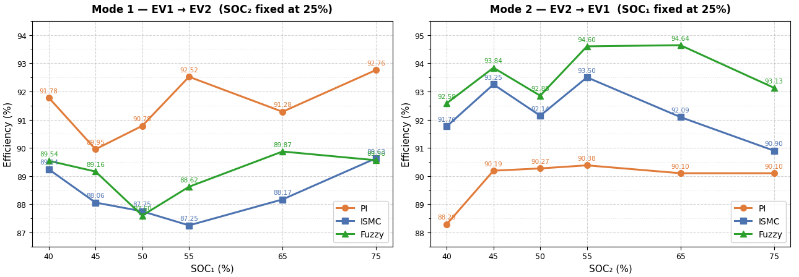
EFFICIENCY COMPARISON
All controllers enable bidirectional charging. Fuzzy achieves the highest reverse-mode efficiency, while ISMC and Fuzzy offers faster transient recovery than PI.

Slide 53
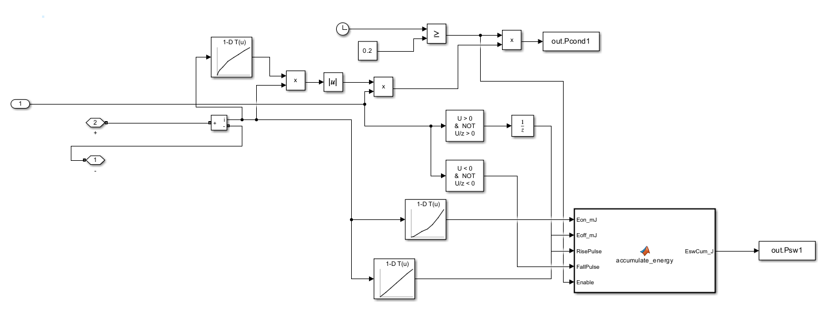
SEMICONDUCTOR LOSSES
Developed a MATLAB/Simulink subsystem to estimate individual IGBT losses using
datasheet-based lookup tables and collector-current feedback.

Slide 54
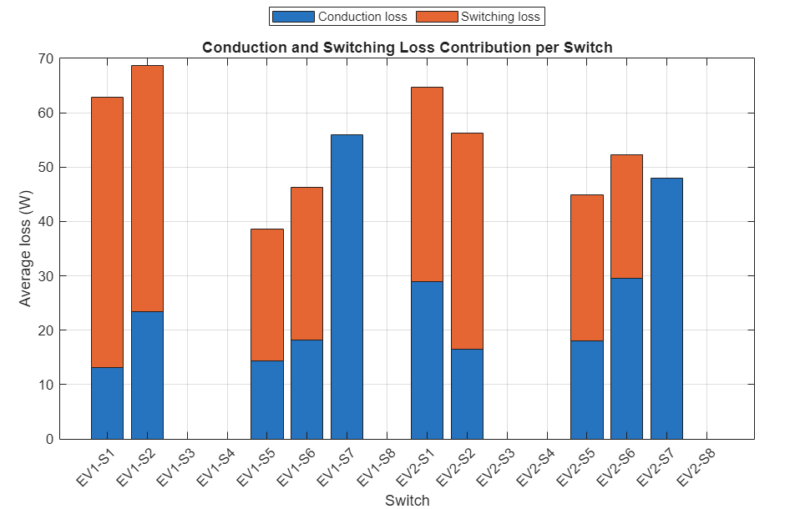
SEMICONDUCTOR LOSSES
Evaluated per-switch conduction and switching losses for both EV sides. [16]
EV1: Conduction loss – 124.96 W; switching loss – 147.23 W.
EV2: Conduction loss – 140.95 W; switching loss – 125.19 W.
Total losses: 272.19 W (EV1) and 266.13 W (EV2).
Loss distribution varies with switch activity and power-transfer direction.

Slide 55
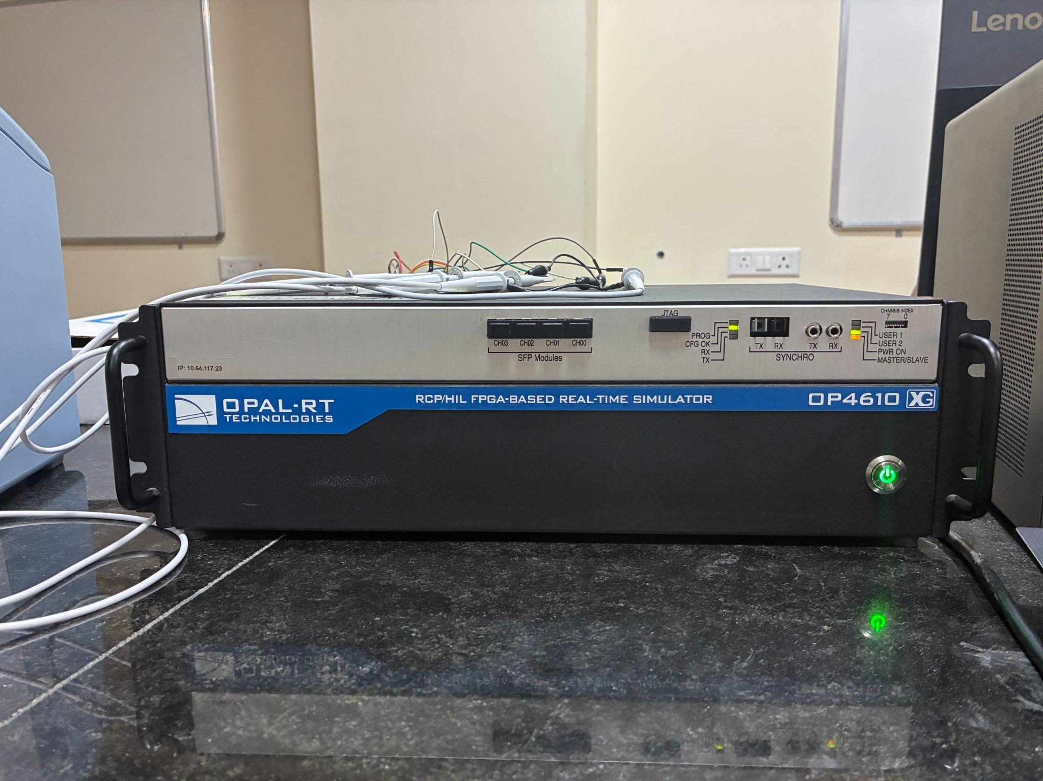
OPAL - RT OP4610XG
Real-Time Simulation: OPAL-RT OP4610XG simulates complex electrical, power electronics, and control systems in real time.
Software-in-the-Loop (SIL): Tests and validates control algorithms in a simulated environment to identify errors and optimize performance before hardware implementation.
Applications: Used in EV powertrains, motor drives, smart grids, and renewable energy systems to validate control strategies and evaluate system performance.
Hardware-in-the-Loop (HIL): Connects physical controllers to simulated systems to test control algorithms without requiring the complete physical setup.

Slide 56
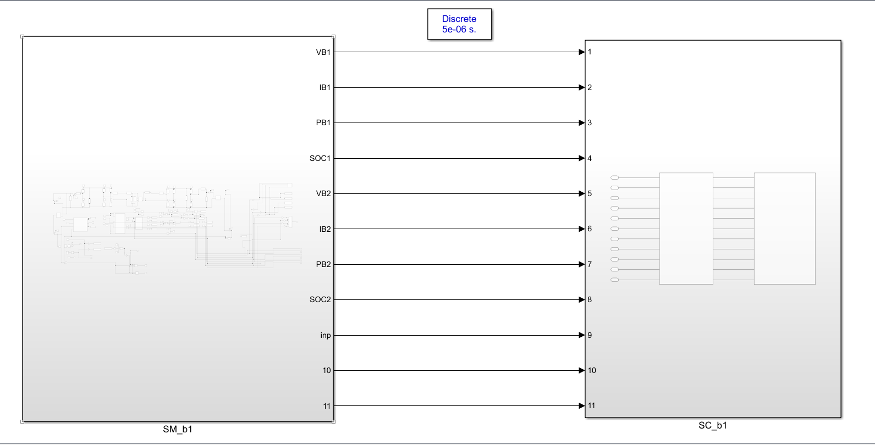

RT-LAB SETUP
Integrated the Simulink plant and controller with RT-LAB using OpComm blocks for real-time simulation.

Slide 57

OPAL-RT SIL(SOFTWARE-IN-LOOP) SETUP
Real-time simulation model generated and deployed on the OPAL-RT OP4610XG platform.
MATLAB/Simulink closed-loop controller integrated into the RT-LAB environment.
Physical signal connections established through the OPAL-RT interface.
Oscilloscope used for signal capture and waveform monitoring.
Validated controller operation and PWM signal behaviour under SIL conditions.

Slide 58

OPAL-RT RESULTS- PI CONTROLLER
Hardware-Synchronized Results in MSO – Mode 1 , EV1 Parameters

Slide 59

OPAL-RT RESULTS- PI CONTROLLER
Hardware-Synchronized Results in MSO -Mode 1 , EV2 Parameters

Slide 60

OPAL-RT RESULTS- PI CONTROLLER
Hardware-Synchronized Results in MSO -Mode 2 , EV1 Parameters

Slide 61

OPAL-RT RESULTS- PI CONTROLLER
Hardware-Synchronized Results in MSO -Mode 2 , EV2 Parameters

Slide 62

OPAL-RT RESULTS- ISMC CONTROLLER
Hardware-Synchronized Results in MSO -Mode 1 , EV1 Parameters

Slide 63

OPAL-RT RESULTS- ISMC CONTROLLER
Hardware-Synchronized Results in MSO -Mode 1 , EV2 Parameters

Slide 64

OPAL-RT RESULTS - ISMC CONTROLLER
Hardware-Synchronized Results in MSO -Mode 2 , EV1 Parameters

Slide 65

OPAL-RT RESULTS - ISMC CONTROLLER
Hardware-Synchronized Results in MSO -Mode 2 , EV2 Parameters

Slide 66

OPAL-RT RESULTS- FUZZY LOGIC CONTROLLER
Hardware-Synchronized Results in MSO -Mode 1 , EV1 Parameters

Slide 67

OPAL-RT RESULTS- FUZZY LOGIC CONTROLLER
Hardware-Synchronized Results in MSO -Mode 1 , EV2 Parameters

Slide 68

OPAL-RT RESULTS- FUZZY LOGIC CONTROLLER
Hardware-Synchronized Results in MSO -Mode 2 , EV1 Parameters

Slide 69
OPAL-RT RESULTS- FUZZY LOGIC CONTROLLER
Hardware-Synchronized Results in MSO -Mode 2 , EV2 Parameters

Slide 70

DEMONSTRATION

Slide 71
CONCLUSIONS
Developed an isolated, single-stage bidirectional V2V converter using existing OBCs and an HFT link.
Validated bidirectional power transfer through MATLAB/Simulink and OPAL-RT SIL.
Compared PI, ISMC and FLC controllers; FLC showed the best overall response in evaluated scenarios.
Estimated semiconductor conduction and switching losses to assess converter efficiency.

Slide 72
FUTURE SCOPE
Hardware-in-the-Loop (HIL) Validation: Validate the converter and control strategies on the OPAL-RT platform under real-time operating conditions.
Si vs. SiC Switch Analysis: Compare silicon and silicon carbide devices in terms of conduction losses, switching losses, and overall converter efficiency.
Hardware Prototype Development: Implement a practical bidirectional V2V converter with compatible OBC interfaces, coordinated switching control, and a dedicated communication link for reliable and secure power transfer.

Slide 73
ACTION PLAN
Timeline | Work Done
Week 1 (Jul 6–12) | Topic finalisation and base paper selection
Week 2 (Jul 13–19) | Literature survey and identification of research gap
Week 3 (Jul 20–26) | Bidirectional V2V converter modelling and component design
Week 4 (Jul 27–Aug 3) | Open-loop simulation setup and initial review
Week 5 (Aug 4–10) | Open-loop results and performance analysis
Weeks 6–7 (Aug 11–24) | Closed-loop PI controller design and tuning
Weeks 8–9 (Aug 25–Sep 7) | ISMC and FLC implementation and controller comparison
Weeks 10–11 (Sep 8–21) | Transient analysis, efficiency evaluation and semiconductor loss estimation
Weeks 12–14 (Sep 22–Oct 9) | OPAL-RT SIL setup, RT-LAB integration and signal monitoring
Week 15- 16 (Oct 12- Oct 16) | Final result analysis

Slide 74
REFERENCES
[1] R. Zhou, B. Chong, B. Labaleine, J. Arnett, and L. Zhang, "A novel isolated connector for bidirectional direct V2V charging using onboard chargers," e-Prime – Nexus of Electrical, Electronic, and Intelligent Engineering, vol. 17, Art. no. 201193, Sep. 2026, doi: 10.1016/j.eprime.2026.201193.
[2] United Nations Department of Economic and Social Affairs, The Sustainable Development Goals Report 2021, United Nations, New York, 2021. [Online]. Available: https://unstats.un.org/sdgs/report/2021/Goal-13/
[3] R. Venugopal, Balaji Chandrasekar, A. Dominic Savio, R. Narayanamoorthi, Kareem M. Aboras, Hossam Kotb, Yazeed Yasin Ghadi, Mokhtar Shouran, Elmazeg Elgamli, “Review on unidirectional non-isolated high gain DC–DC converters for EV sustainable DC fast charging applications,” IEEE Access 11 (2023) 78299–78338.
[4] Milad Haghani, Frances Sprei, Khashayar Kazemzadeh, Zahra Shahhoseini, Jamshid Aghaei, “Trends in electric vehicles research,” Transp. Res. Part D: Transp. Environ. 123 (2023) 103881.
[5] Murat Yilmaz, Philip T. Krein, “Review of battery charger topologies, charging power levels, and infrastructure for plug-in electric and hybrid vehicles,” IEEE Trans. Power Electron., 28 (5) (2013) 2151–2169.

Slide 75
REFERENCES
[6] Azizulrahman Shafiqurrahman, B.S. Umesh, Naji Al Sayari, Vinod Khadkikar, “Electric vehicle-to-vehicle energy transfer using on-board converters,” IEEE Trans. Transp. Electrification 9 (1) (2023) 1263–1272.
[7] Seyedfoad Taghizadeh, M. Jahangir Hossain, Noushin Poursafar, Junwei Lu, Georgios Konstantinou, “A multifunctional single-phase EV on-board charger with a new V2V charging assistance capability,” IEEE Access 8 (2020) 116812–116823.
[8] Emin Ucer, Ramona Buckreus, Md Ehsanul Haque, Mithat Kisacikoglu, Yilmaz Sozer, Salman Harasis, Mustafa Guven, Luigi Giubbolini, “Analysis, design, and comparison of V2V chargers for flexible grid integration,” IEEE Trans. Ind. Appl. 57 (4) (2021) 4143–4154.
[9] Viet T. Tran, Md. Rabiul Islam, Kashem M. Muttaqi, Omar Farrok, Mahbubur Rahman Kiran, Danny Sutanto, “A novel universal magnetic power plug to facilitate V2V/V2G/G2V/V2H connectivity for future grid infrastructure,” IEEE Trans. Ind. Appl. 58 (1) (2022) 951–961.
[10] Vaibhav Shah, Saifullah Payami, “Integrated converter with G2V, V2G, and DC/V2V charging capabilities for switched reluctance motor drive-train based EV application,” IEEE Trans. Ind. Appl. 59 (3) (2023) 3837–3850.

Slide 76
REFERENCES
[11] Haifeng Fan, Hui Li, “High-frequency transformer isolated bidirectional DC–DC converter modules with high efficiency over wide load range for 20 kVA solid state transformer,” IEEE Trans. Power Electron. 26 (12) (2011) 3599–3608.
[12] Kyoohyun Noh, Minglei Zhang, Edgar Sánchez-Sinencio, “A unified amplifier based CC-CV linear charger for energy-constrained low-power applications,” IEEE Trans. Circuits Syst. II: Express Briefs 66 (3) (2019) 377–381.
[13] S. Deshmukh (Gore), A. Iqbal, S. Islam, I. Khan, M. Marzband, S. Rahman, and A. M. A. B. Al-Wahedi, “Review on classification of resonant converters for electric vehicle application,” Energy Reports, vol. 8, pp. 1091–1113, 2022, doi: 10.1016/j.egyr.2021.12.013.
[14] V. Veerakgoundar and S. Subramaniam, “An efficient and compact voltage feed-forward DAB-based bidirectional DC–DC converter for onboard EV charger,” Computers and Electrical Engineering, vol. 122, Art. no. 109979, 2025, doi: 10.1016/j.compeleceng.2024.109979.
[15] Erdem Gümrükcü, Jonatan Ralf Axel Klemets, Jon Are Suul, Ferdinanda Ponci, Antonello Monti, “Decentralized energy management concept for urban charging hubs with multiple V2G aggregators,” IEEE Trans. Transp. Electrification, 9 (2) (2023) 2367–2381.
[16] Infineon Technologies AG, “IKWH75N65EH7: High speed and low saturation voltage 650 V TRENCHSTOP™ IGBT7 technology,” Datasheet, Nov. 15, 2023. [Online]. Available: https://www.infineon.com/

